Slide 1




Telescopes through the Ages
Past, Present & Future
Notes:
15 minute talk, including time for questions

Slide 2

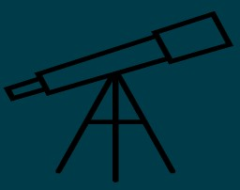
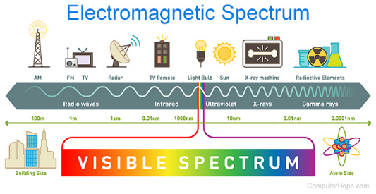
What light can we capture?
Traditional telescopes as we might understand them use visible light.
BUT what about when it’s cloudy or if we want to observe during the day?
Like in an airport when we use x-rays to look into something we can’t see, we collect different forms of EM radiation to create a clearer image of space.
One way to see into space is with radio waves that aren’t blocked out by our atmosphere
Notes:
Optical telescopes are the most well known.
Our atmosphere blocks UV for example, so we can either look at a different frequency or go outside of the atmosphere for a clearer picture.

Slide 3
Nearly 200 years of astronomical research in Birr, from the Leviathan to I-LOFAR…

Slide 4
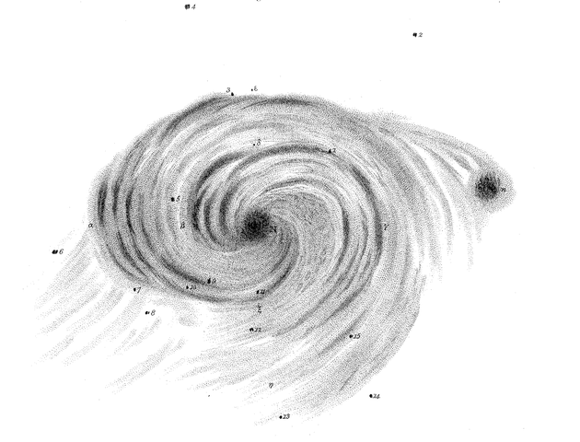
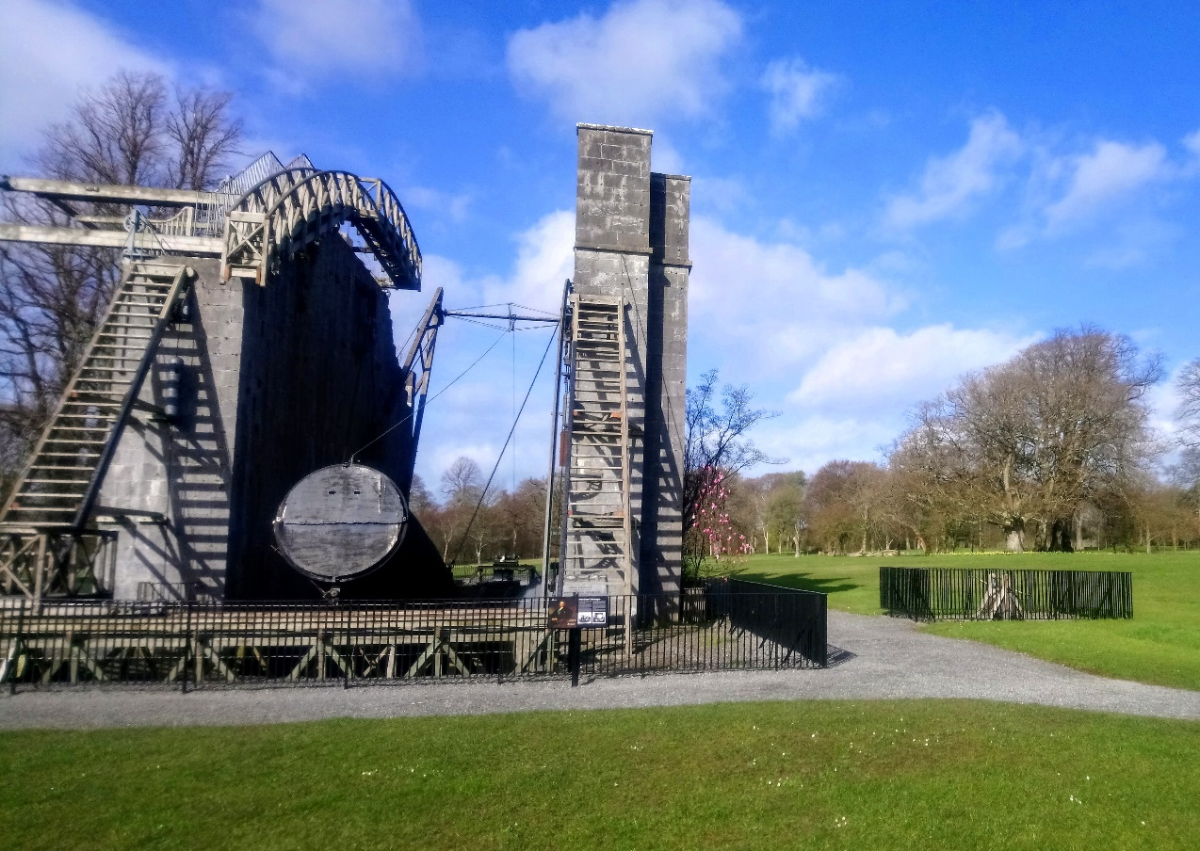
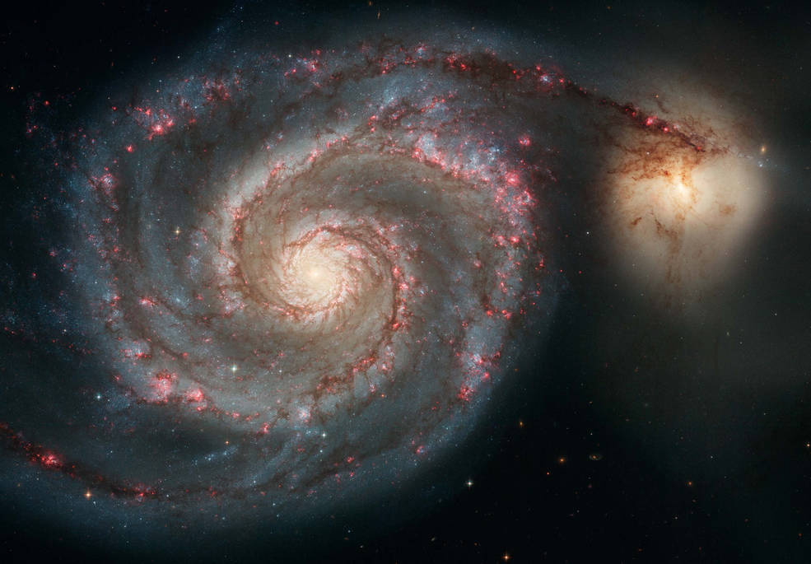
Astronomy at
Birr Castle
The Leviathan Telescope at Birr Castle Demesne
Notes:
Completed in 1845, largest telescope in the world for over 70 years was at Birr Castle

Slide 5
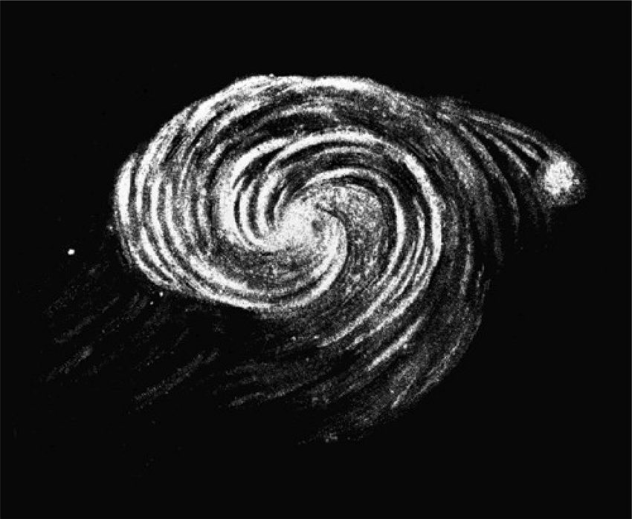
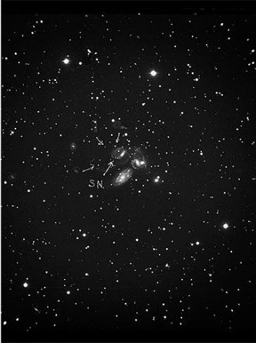
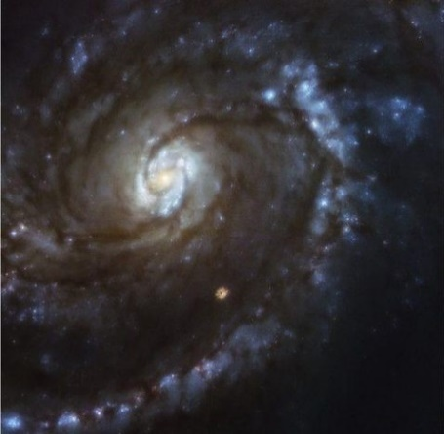
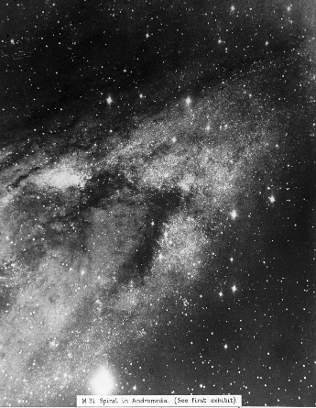
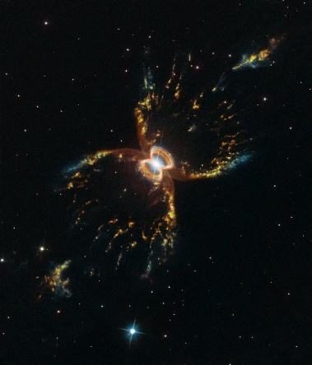
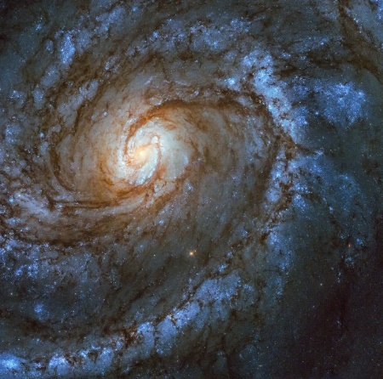
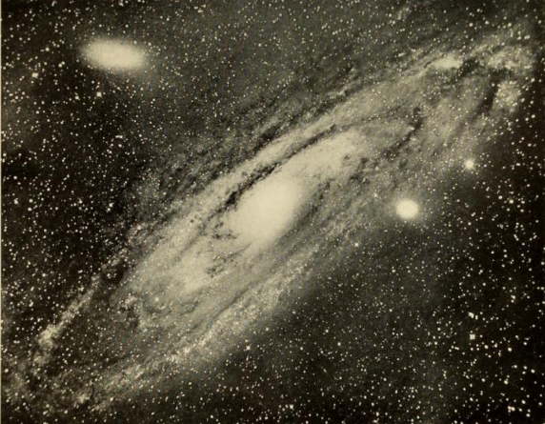

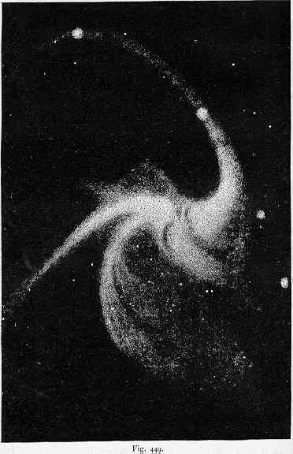
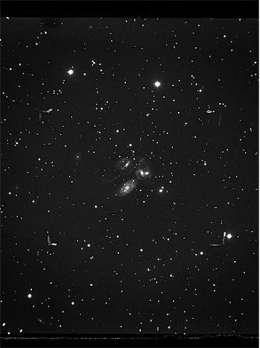
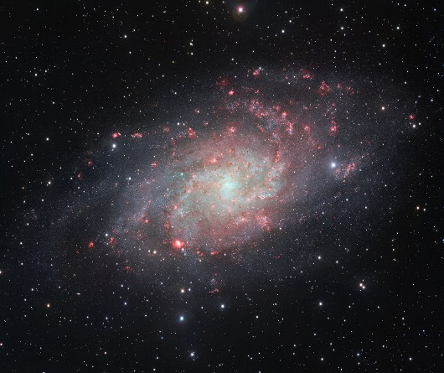
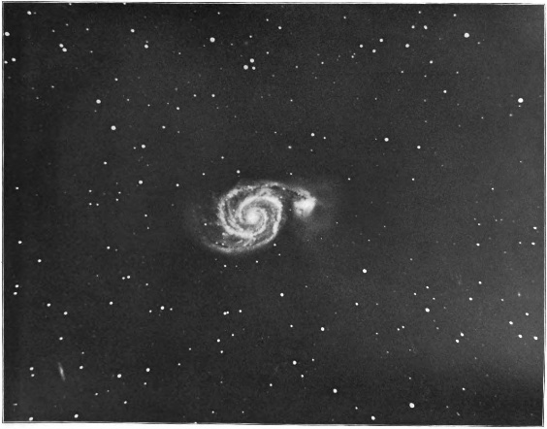
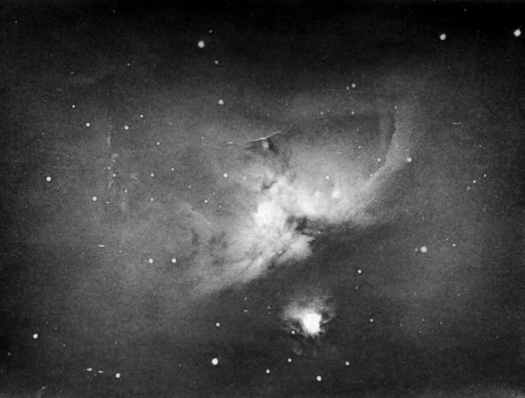
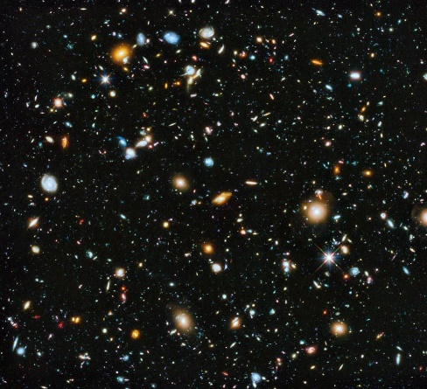
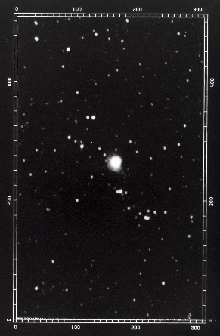
?
Notes:
In groups arrange the pictures in chronological order

Slide 6
1845
1850
1883
1900
1902
1922
1964
1971
1985
1990
2005
2013
2014
2018
2019
Notes:
Anything you notice?
Trends – black & white to colour, etc
Similarities?

Slide 7
1845
1850
1883
1900
Drawing of M51 the Whirlpool Galaxy as observed through the Leviathan in Birr in 1845
Drawing of M33, the Triangulum Spiral Galaxy, from observations with the Leviathan, around 1850
Photograph of the Orion Nebula using a 36 inch reflecting telescope in the UK in 1883
Andromeda Galaxy, Yerkes Observatory USA around 1900
Notes:
1845 William Parsons drawing of M51, the Whirlpool Galaxy as observed through the 72-inch (1.8 m) Leviathan Telescope in Birr – 23.16 million light years away
1850 Drawing of M33, the Triangulum spiral galaxy, created by R.J. Mitchell based on observations by William Parsons with the Leviathan Telescope in Birr, around 1850 – 2.7 million light years away
1883 Photo of the Orion Nebula by A. A. Common with a 36-inch (0.9 m) telescope in the UK – 1,344 light years away
1900 Andromeda Galaxy, Yerkes Observatory USA around 1900 – 2.5 million light years away

Slide 8
A photo of the Whirlpool Galaxy, M51 taken in Yerkes Observatory USA 1902
Supernova using the Hale telescope at Palomar Observatory USA in 1964
N81 obtained at the ESO 3.6 m telescope in November 1985
1902
1922
1964
1971
1985
1990
Nearby galaxy M100 viewed in the early 1990s with Hubble Space Telescope
Supernova using the Hale telescope at Palomar Observatory USA in 1971
Andromeda, through the Hooker Telescope USA by Edwin Hubble 1920-22
Notes:
1902 Photo of the Whirlpool Galaxy, M51 taken in Yerkes Observatory USA on June 3, 1902
1920-22 Andromeda Galaxy through the 100-inch (2.5 m) Hooker Telescope USA by Edwin Hubble
1964 supernova using the 200-inch (5.1 m) Hale telescope at Palomar Observatory, USA in 1964
1971 supernova using the 200-inch (5.1 m) Hale telescope at Palomar Observatory, USA in 1971
1985 Nebula N81 in Small Magellanic Cloud obtained at the ESO (European Southern Observatory) 3.6 m telescope in Chile, November 1985 – 200,000 light years away
1990s nearby galaxy M100 is viewed in the early 1990s with Hubble Space Telescope, 94.5-inches (2.4 m) - 55 million light years away

Slide 9
Whirlpool Galaxy, M51 by Hubble Space Telescope, released 25 April 2005
Hubble Ultra Deep Field taken and released in 2013-2014
Triangulum Galaxy, M33, recorded with the ESO VLT Survey Telescope 2014
Nearby galaxy M100 with Hubble Space Telescope
The Southern Crab Nebula by Hubble Space Telescope, 18 April 2019
2005
2013
2014
2018
2019
Notes:
2005 Whirlpool Galaxy, M51 by Hubble Space Telescope, released 25 April 2005
2013 Hubble Ultra Deep Field by NASA with the Hubble Space Telescope, taken/released in 2013-2014 – shows a large number of objects, many of these are other galaxies. You can make out some spiral structures.
2014 Triangulum Galaxy, also known as M33, taken with the ESO VLT (Very Large Telescope) Survey Telescope 2011-2014 – 2.7 million light years away (same object in 1850 image)
2018 Nearby galaxy M100 is viewed in 2018 with Hubble Space Telescope (same object in 1990 image)
2019 The Southern Crab Nebula by Hubble Space Telescope, 18 April 2019 – 6,849 light years away

Slide 10
1845
1850
1883
1900
1902
1922
1964
1971
1985
1990
2005
2013
2014
2018
2019
Notes:
How can we make better telescopes?
Materials
Size
Magnification capabilities
Longevity & maintenance
Position
Type of EM radiation
Materials can be made more reflective, stronger and requiring less upkeep.
A bigger aperture allows more detail
On the ground vs out in space
Can we just keep making bigger and bigger telescopes?

Slide 11
How can we make better telescopes?
Notes:
How can we make better telescopes? Consider
Materials
Size
Magnification capabilities
Longevity & maintenance
Position
Type of EM radiation

Slide 12
Discussion:
How can we make better telescopes?
Materials
Size
Magnification capabilities
Longevity & maintenance
Position
Type of EM radiation
Notes:
Materials can be made more reflective, stronger and requiring less upkeep.
A bigger aperture allows more detail
On the ground vs out in space

Slide 13
Discussion:
How can we make better telescopes?
Can we just keep making bigger and bigger telescopes?
Notes:
Materials can be made more reflective, stronger and requiring less upkeep.
A bigger aperture allows more detail
On the ground vs out in space

Slide 14
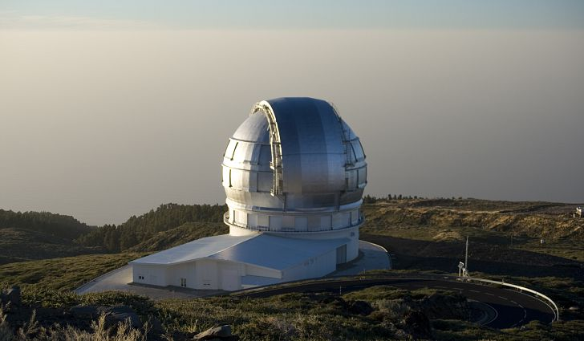
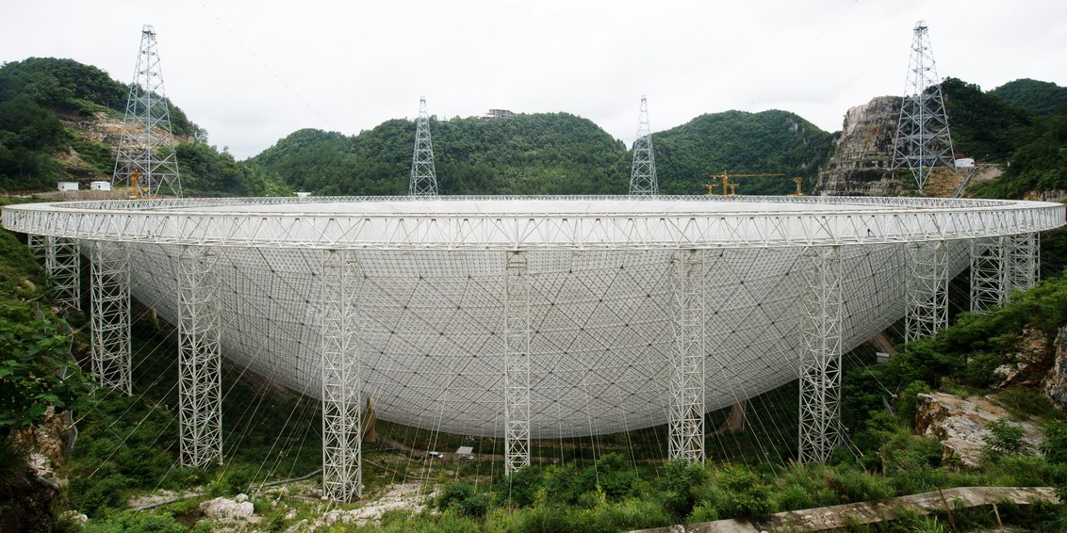
Notes:
Top image: The worlds largest single-aperture optical telescope is Gran Telescopio Canarias on La Palma, in the Canaries, Spain, built in 2009. It has a 10.4 m aperture.
Bottom image: FAST (Five-hundred-meter Aperture Spherical radio Telescope) a radio telescope in Guizhou, China. It has a 500 m diameter dish and is built into a basin/natural depression in the landscape for support.

Slide 15
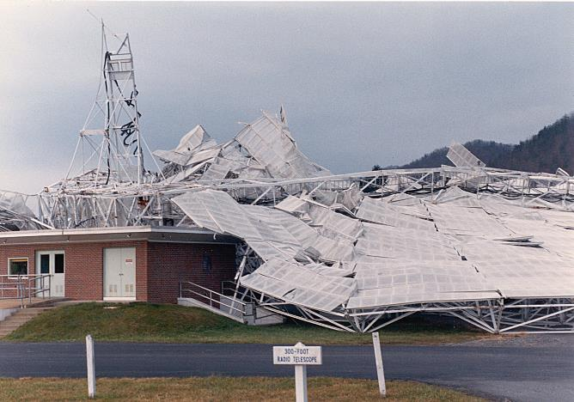
Physical Limitations
Notes:
After the collapse of a 91.4 m radio telescope in Green Bank, West Virginia, USA
Singular stationary radio telescopes are confined by gravity but what about using multiple telescopes in tandem?

Slide 16
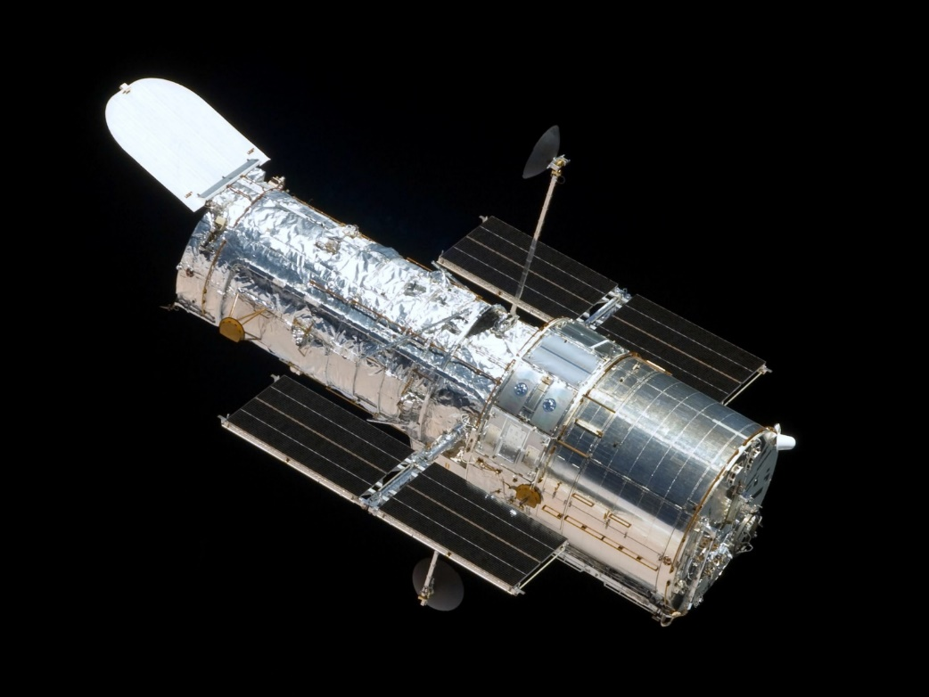
Notes:
Hubble Space Telescope, orbiting Earth since 1990.

Slide 17
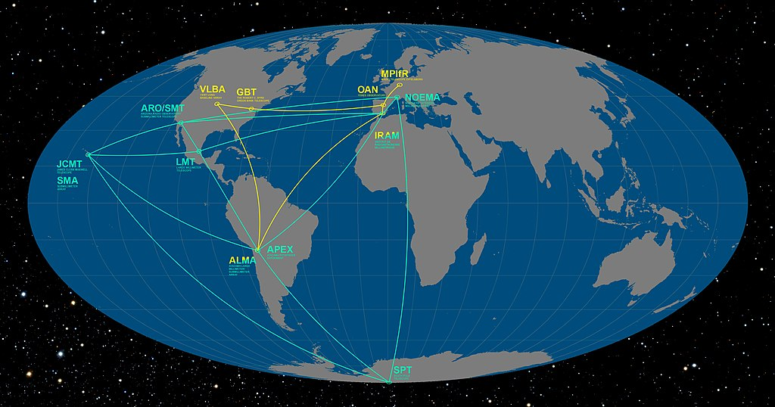
Notes:
Event Horizon Telescope locations

Slide 18
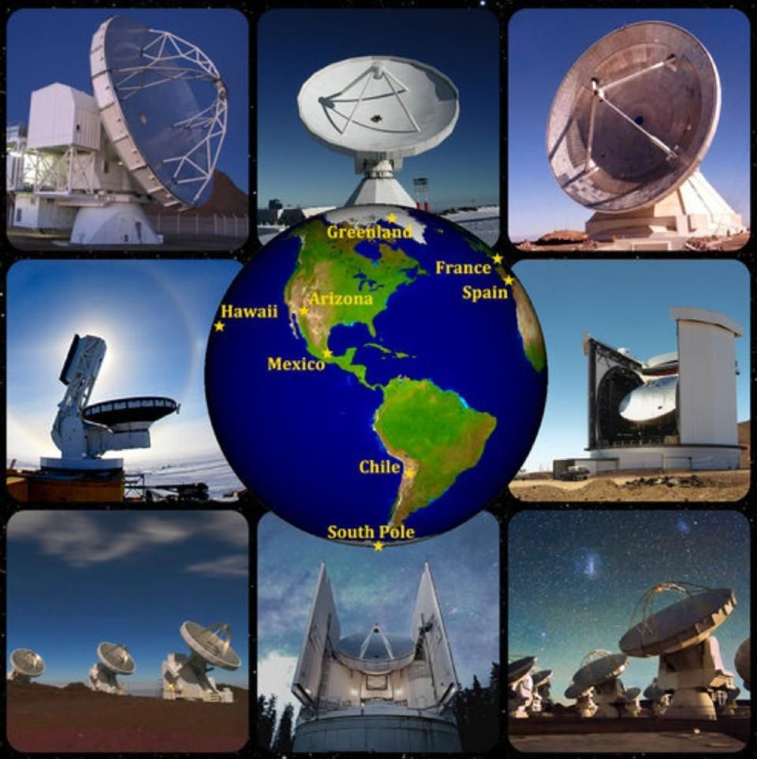
Notes:
Event Horizon Telescope locations

Slide 19
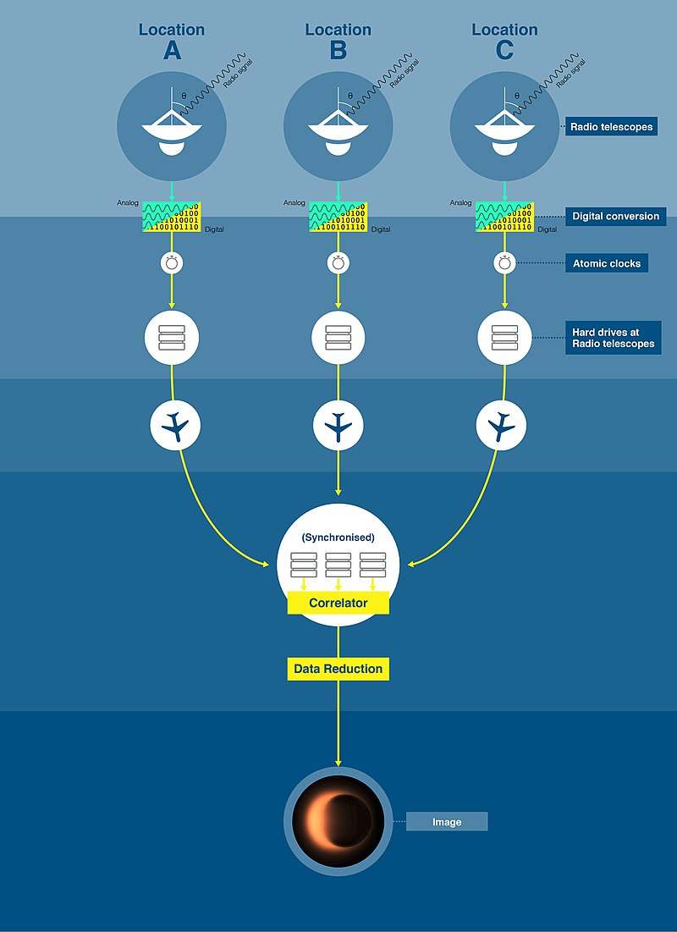
Notes:
EHT took and image of a black hole in 2019.

Slide 20
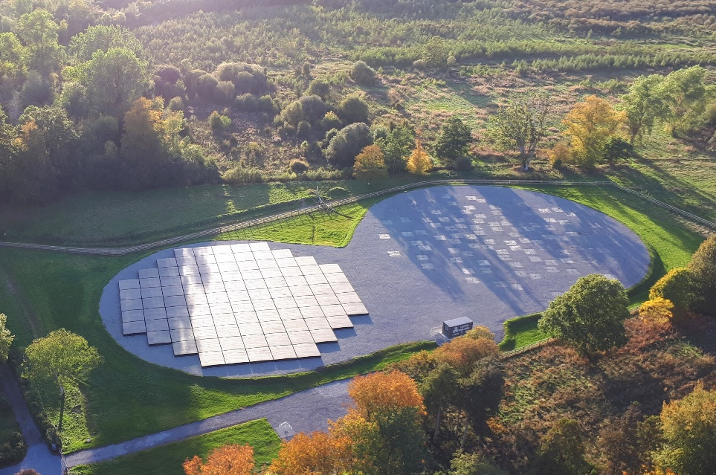

I-LOFAR
Credit: Alison Delaney, Birr Castle
International LOFAR Telescope
Notes:
Past to present

Slide 21
Future telescopes…

Slide 22
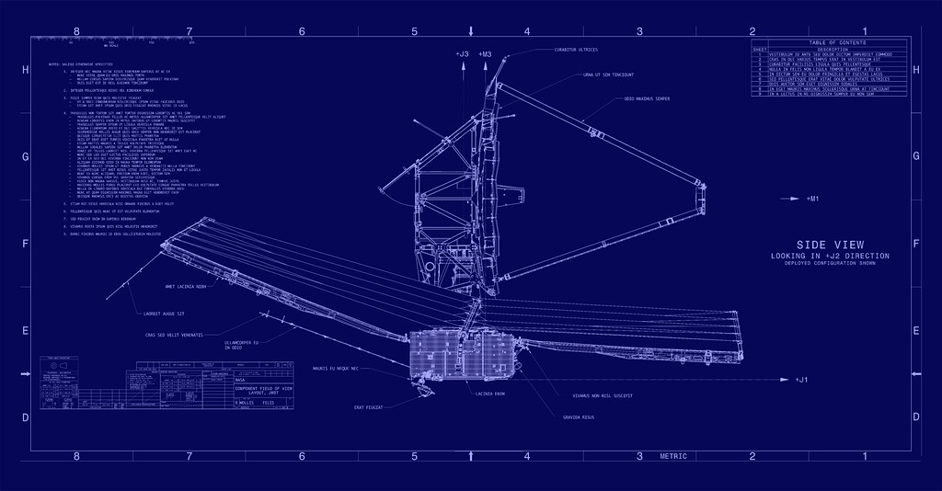
Notes:
Blueprints for the James Webb Space Telescope (JWST)

Slide 23
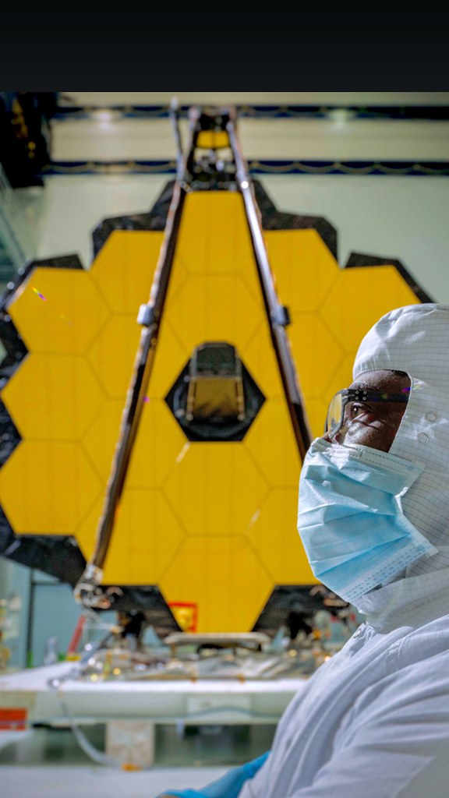
Notes:
JWST primary mirror.

Slide 24
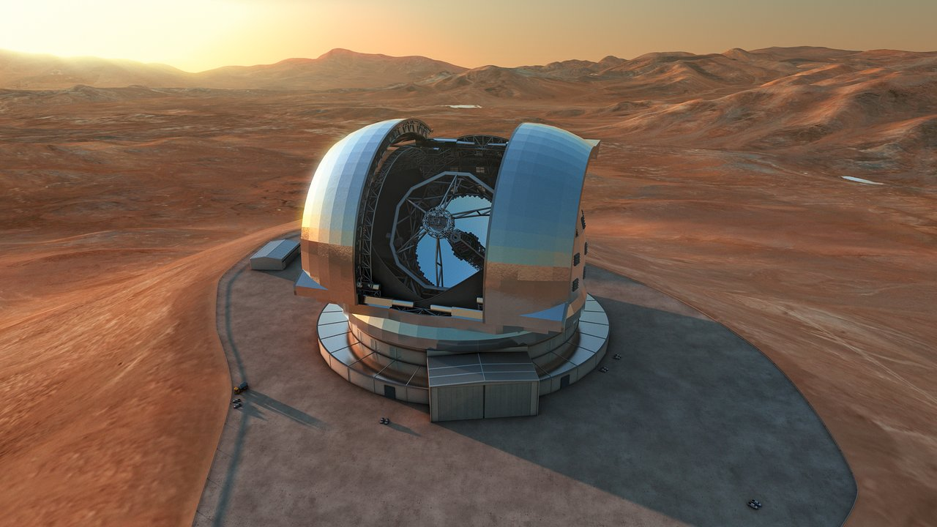
Notes:
ELT, part of ESO in Chile.
Plans to be completed by 2025. This is an impression of what it will look like – thise are cars on the ground beside it.

Slide 25
What might we discover with future telescopes?
Notes:
Seeing the difference in less than 200 years, can you imagine what we might achieve in another 200 years?

