Slide 1




Our Moon

Slide 2

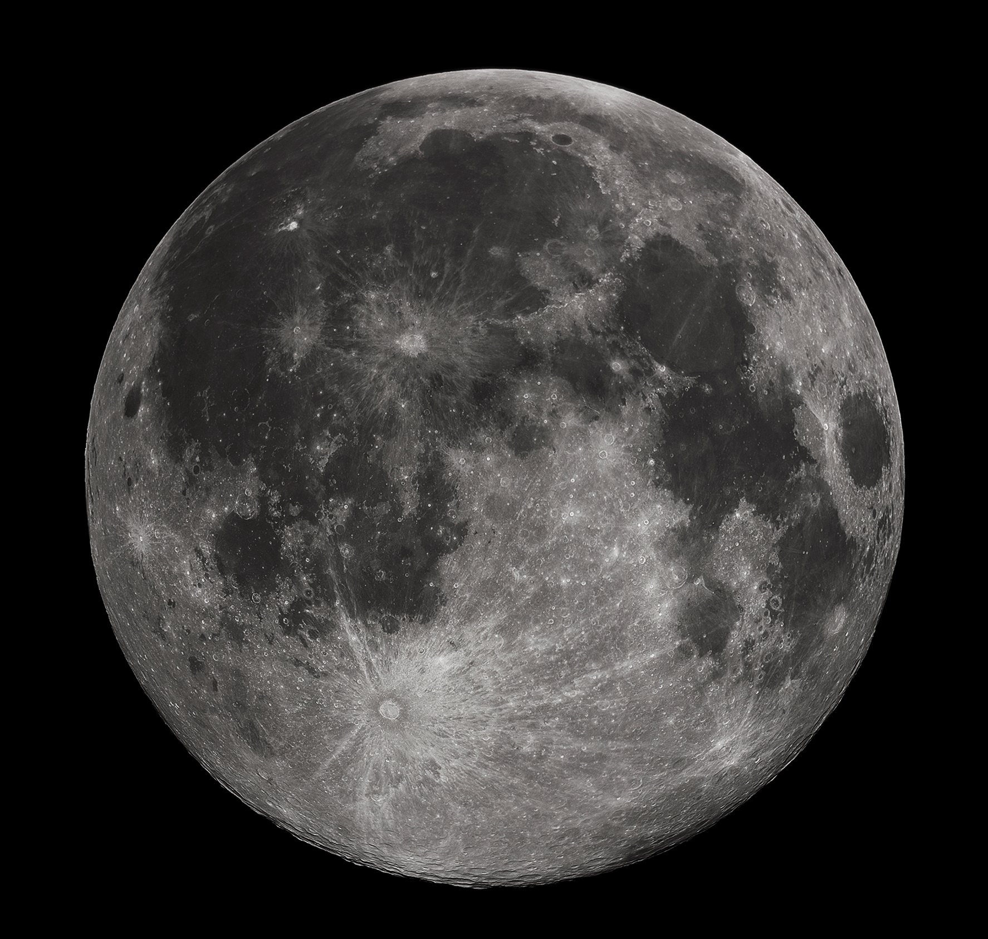
Our Moon
x400 smaller in diameter than the Sun
x400 closer to Earth than the Sun
We only see one face
Earth’s only natural satellite
Gravity is only about 17% as strong as gravity on Earth.

Slide 3
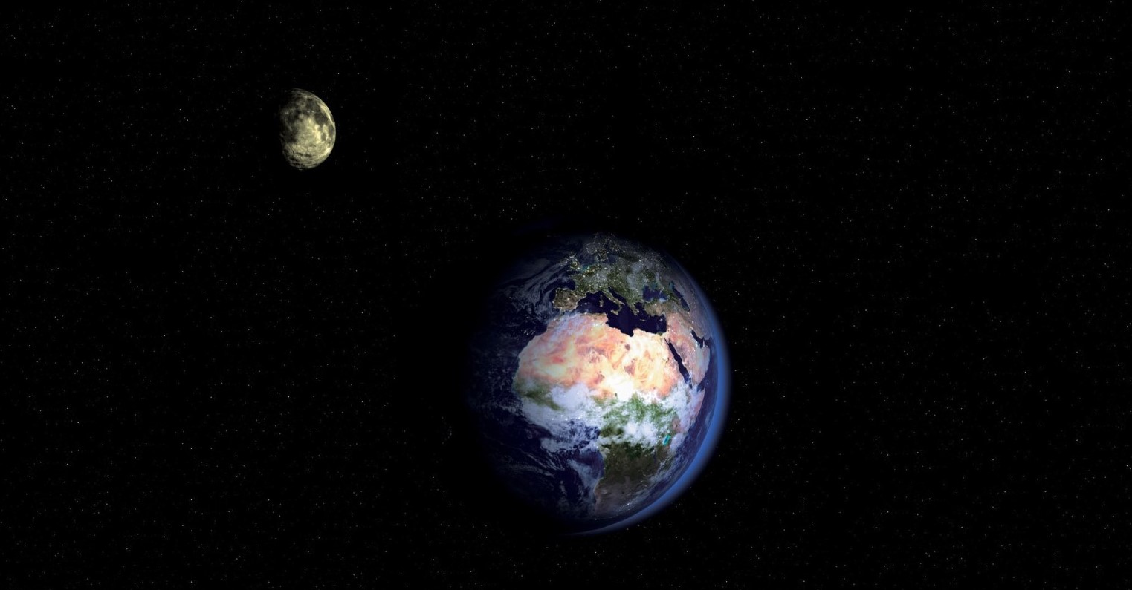
Does the Moon rotate like Earth?
If we only see one face of the Moon, is it rotating on its axis whilst orbiting the Earth?

Slide 4
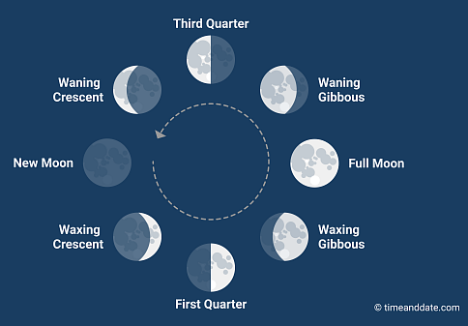
Phases
The moons different shapes come from the way the Sun illuminates the Moon, and how much of that illumination we can see from Earth
You are here
Sun

Slide 5
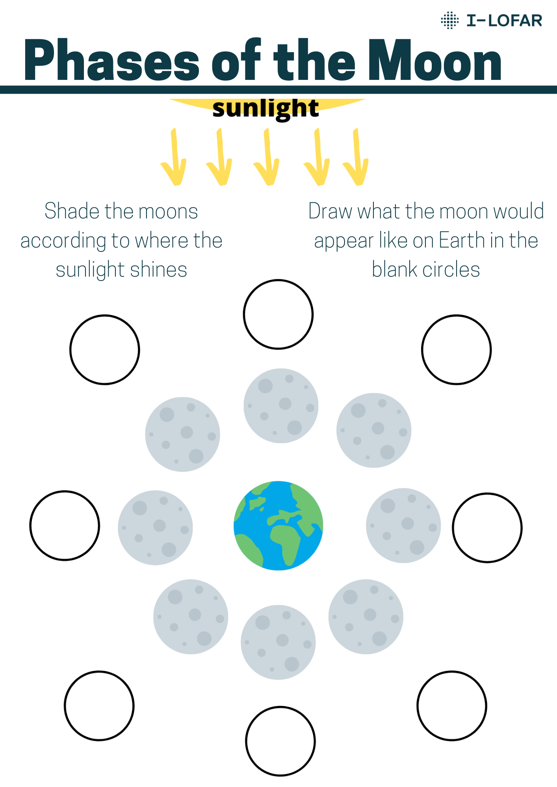
Phases
The Moons different shapes come from the way the Sun illuminates the Moon, and how much of that illumination we can see from Earth

Slide 6
Phases
New Moon
Waxing Crescent
Waning Crescent
First Quarter
Third Quarter
Waxing Gibbous
Waning Gibbous
Full Moon

Slide 7
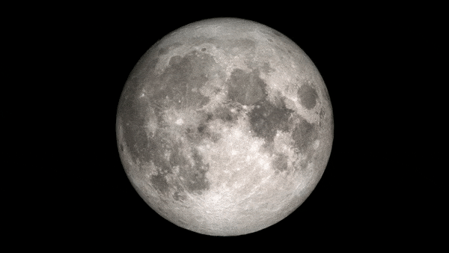

Phases
Notes:
The moons different shapes come from the way the Sun illuminates the Moon, and how much of that illumination we can see from Earth

Slide 8


Eclipses – spot the difference
Notes:
Lunar - The Earth comes between the straight path of the Sun and the Moon. This blocks light from reflecting off the Moon.
Solar- The Moon comes between the straight path of the Sun and Earth. This blocks light from the Sun shining on Earth.

Slide 9
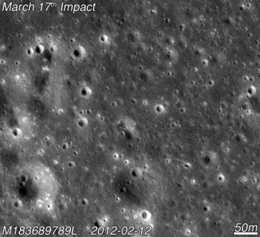
Craters
Why has the Moon so many craters in comparison to Earth?
Lack of atmosphere – break up asteroids
Lack of erosion
Lack of plate tectonics
Lack of volcanic activity
Notes:
Therefore any craters on the Moon stay there, whereas on Earth if an asteroid isn’t broken up it by the atmosphere, it doesn’t take long for the crater to be destroyed/covered.

