Slide 1

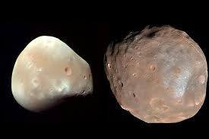
Moon Topography
Notes:
Investigating the moon ‘s surface

Slide 2
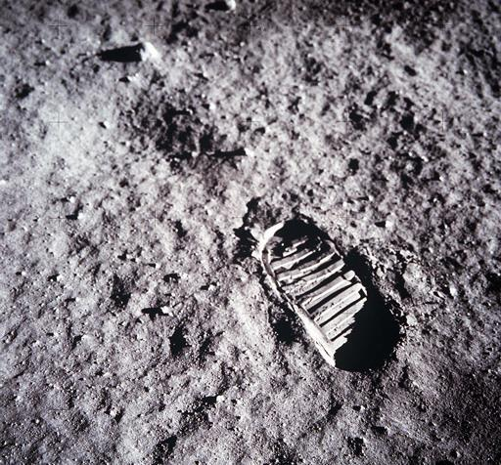
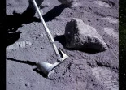
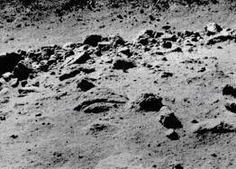
Notes:
Nearly the entire Moon is covered by a rubble pile of charcoal-gray, powdery dust and rocky debris called the lunar regolith between 4 and 15 metres deep
Lunar dust is fine like a powder, but it is so sharp it can cut like glass. It is formed when meteorites crash onto the Moon’s surface, heating and smashing rocks and dirt which contain silica and metals such as iron. The absence of air and water to smooth rough edges means that the tiny grains are sharp and jagged and cling to everything. Dust particles remain untouched unless an impact occurs. The dust is electrically charged and sticks to any surface on contact. There is some evidence that the dust particles are constantly leaping up and falling back to the Moon’s surface. The soil becomes increasingly compacted beneath the top layer of regolith.

Slide 3
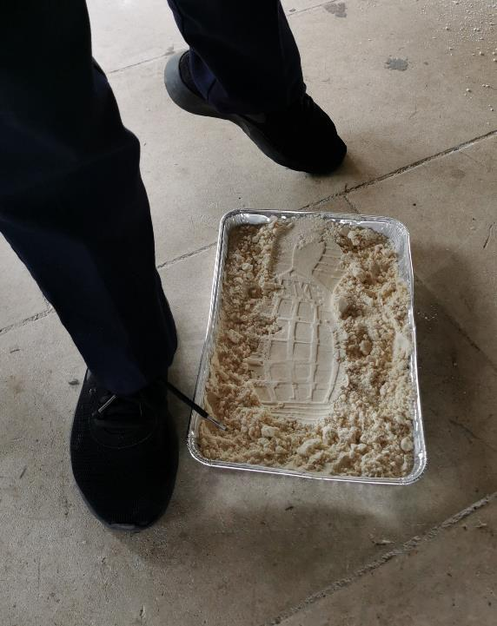
Footsteps on the Moon
Regolith Recipe
8 cups of flour
1 cup of baby oil
Notes:
Regolith Recipe : 8 cups flour 1 cup baby oil

Slide 4
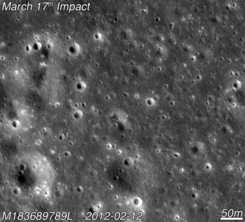
Craters
Why does the Moon have so many craters in comparison with Earth?
Lack of atmosphere to break up asteroids
Lack of erosion
Lack of plate tectonics
Lack of volcanic activity
Notes:
Therefore any craters on the Moon stay there, whereas on Earth if an asteroid isn’t broken up it by the atmosphere, it doesn’t take long for the crater to be destroyed/covered.

Slide 5
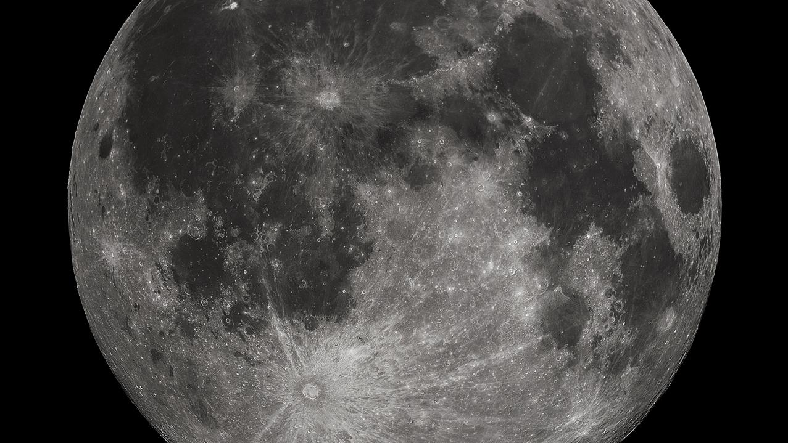
Tycho Crater
Notes:
The most famous and obvious crater on the moon, Tycho crater 83km diameter. Faces are higher then those of the grand canyon

Slide 6
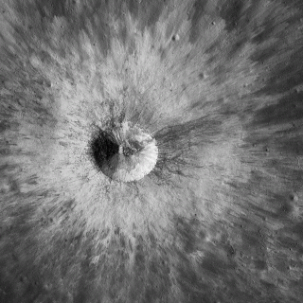
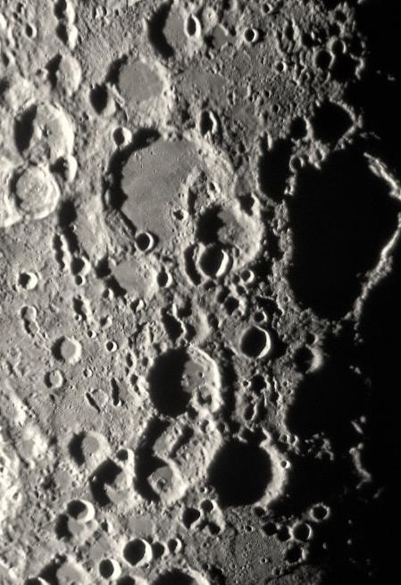
Ejecta
Central Peak Uplift
Wall
Ejecta Pattern - Rays
Notes:
Craters are usually 10 to 20 times bigger that the asteroid that impacted as it explodes on impact
Avg size of craters are 15–25 km across. One of the biggest craters in the entire solar system is on our moon it's 2,500 km (1,600 mi) in diameter and 13 km (8.1 mi) deep. Same distance as Ireland to Morocco

Slide 7
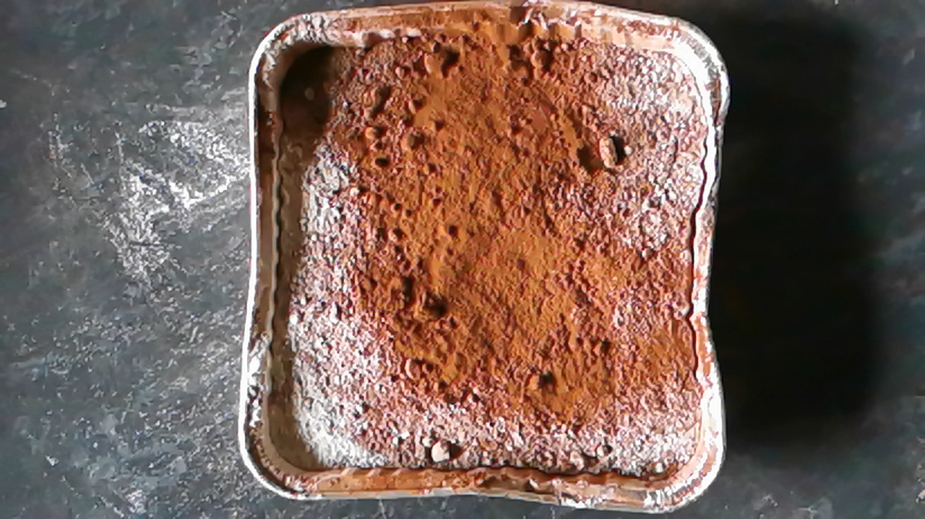
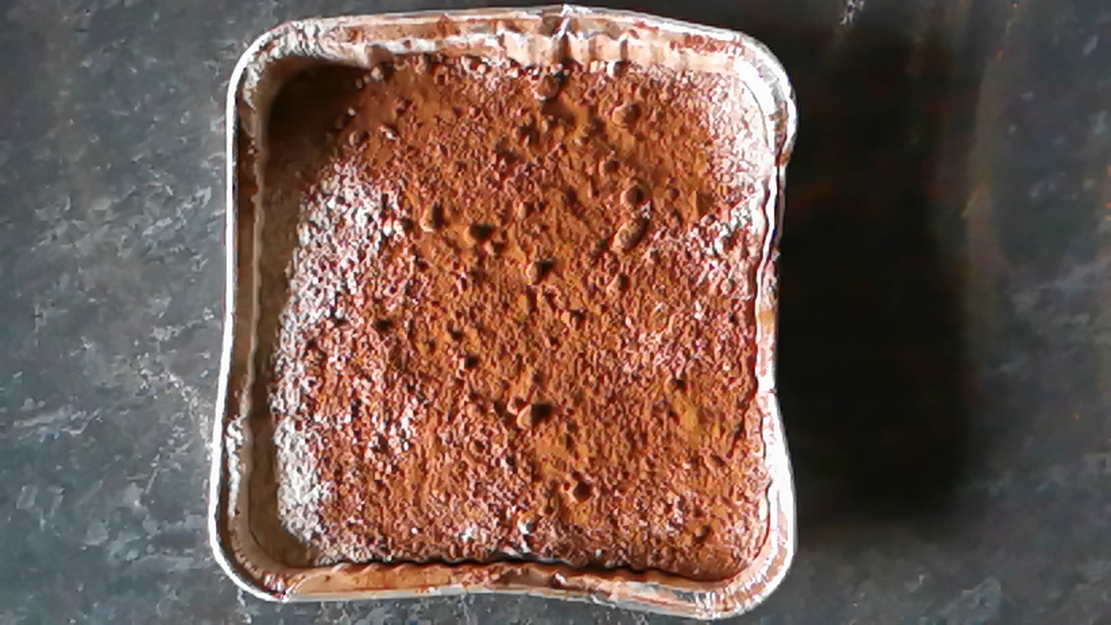
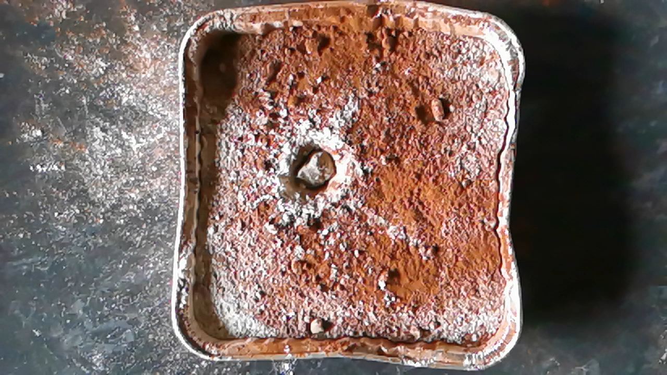
Class Investigation
Notes:
Educator Guide: Whip Up a Moon-Like Crater | NASA/JPL Edu

Slide 8
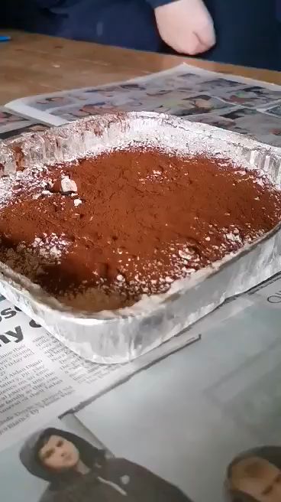
Getting to the bottom of craters?
Class Investigation
What shape are craters?
Does the size of an object effect crater size?
Does the speed of an object effect crater size and shape?
Does the angle of an object effect crater shape?
Notes:
If you throw a stone into mud at an angle you normally end up with a ‘crater’ that’s elliptical or elongated. It’s natural to suppose the same would be true of a meteoroid hitting the Earth or another planet. But these kinds of impact craters are formed in an entirely different way to the ‘mechanical’ process of a stone hitting mud.
Meteoroids are moving at extremely high velocities (up to tens of kilometres per second). At the moment of impact this enormous kinetic energy is almost entirely converted into heat, which then vaporises the meteoroid instantly. It’s this ‘explosion’ and not the meteoroid itself that creates the impact crater. Since material is ejected equally in all directions, regardless of the direction of travel of the meteoroid, the resulting crater is circular. There can be exceptions to this but only if the impact occurs at an extremely shallow angle.
These craters were formed millions of years ago when meteorites hit the Moon’s surface. The impact of the meteorites caused the hollows to form and some of the surface to be thrown up and out around the crater. This is called ejecta (because it was ejected from the surface). Meteorites are bits of rock in space, which people think may have been left over from the start of the solar system (the planets and moons).

Slide 9
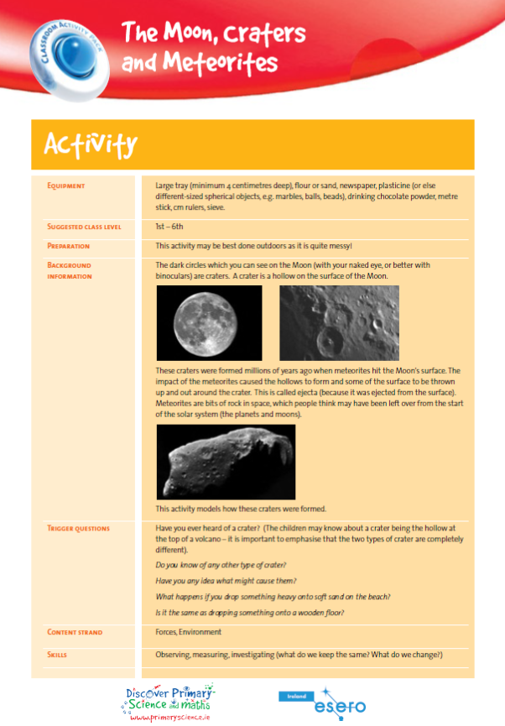
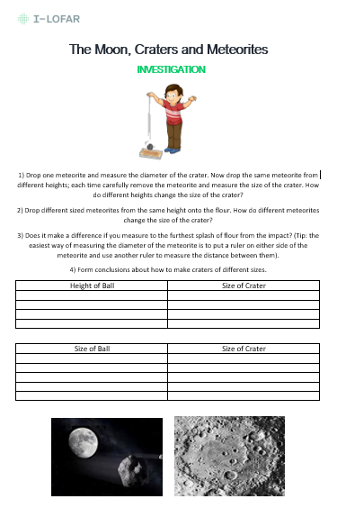
www.esero.ie
Notes:
meteorites_activity.pdf (esero.ie)
Investigate the size and shape of craters by looking at size, speed and angle of meteorite

Slide 10
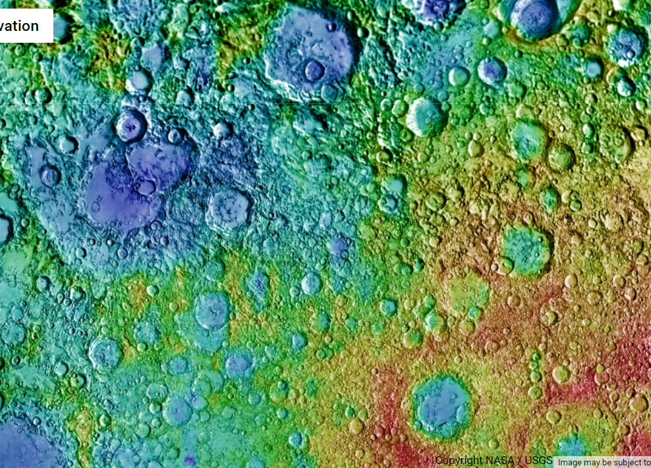
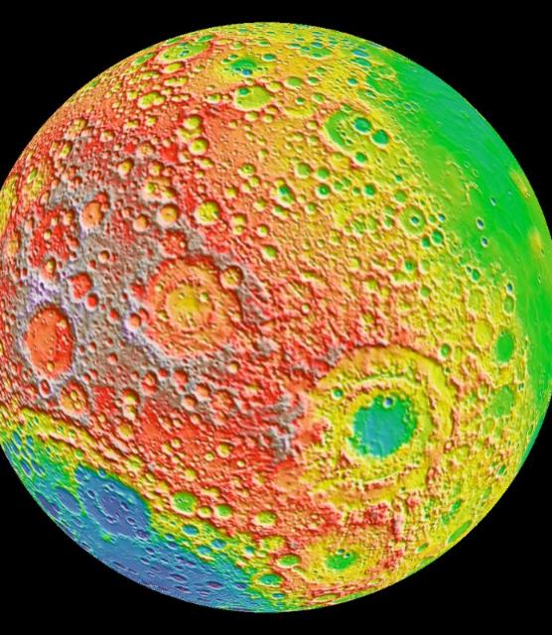
Google Moon
Notes:
Using tablets or interactive whiteboard, exploring Google Moon can really give a feel for the highlands, lowlands and craters on the moon’s surface.

Slide 11
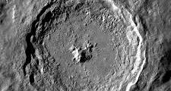
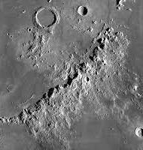
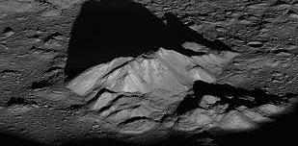
Notes:
Larger asteroids and comets, especially those with high velocities, can impart a tremendous amount of force on the Moon’s surface. In such cases, in addition to a crater being formed, the surface in and around the impact point is compressed further. This causes the crust to melt. When the melted crust can’t be compressed any further, it bounces right back up, forming a central mountain.

Slide 12
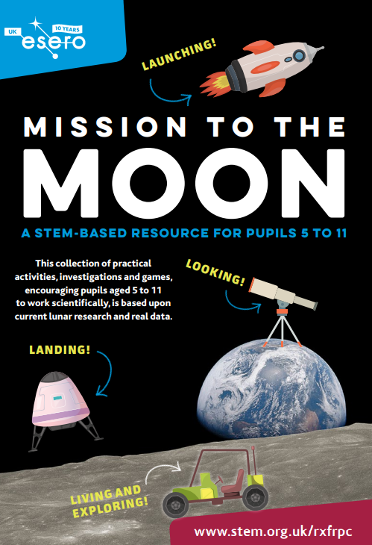
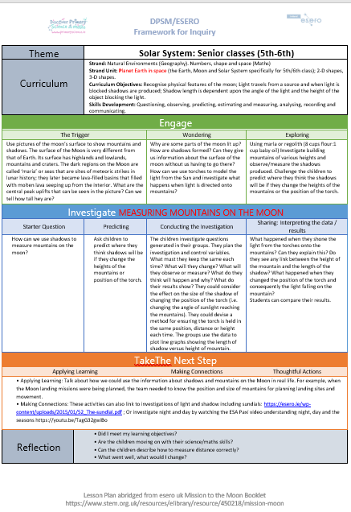
https://www.stem.org.uk/system/files/elibrary-resources/2019/06/Mission%20to%20the%20Moon.pdf
Notes:
Wonderful resources for all aspects of a Mission the Moon can be found here: https://www.stem.org.uk/system/files/elibrary-resources/2019/06/Mission%20to%20the%20Moon.pdf

Slide 13
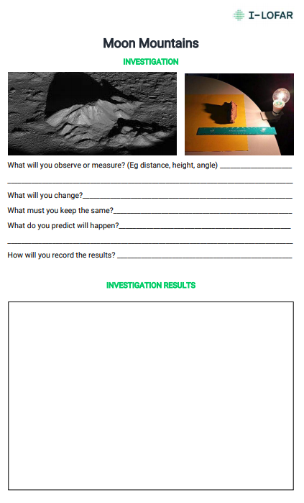
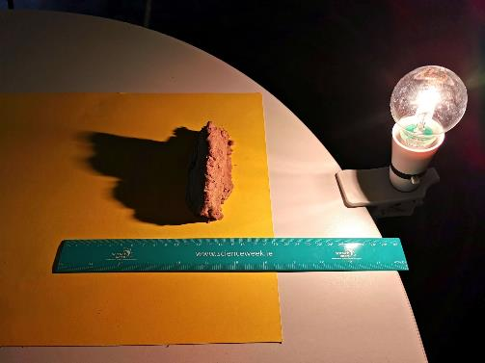
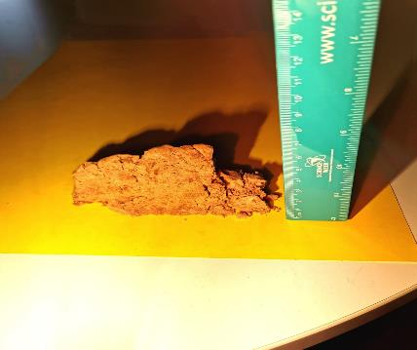
Notes:
Using images of the moon’s surface you can detect mountains and their shadows. Astronomers can determine the height of the mountains by measuring the shadows and comparing them to the angle of the light hitting the mountain. This activity explores how we can measure mountains on the moon. Use regolith from footsteps or crater activity, marla or playdough to mould the mountains.

Slide 14
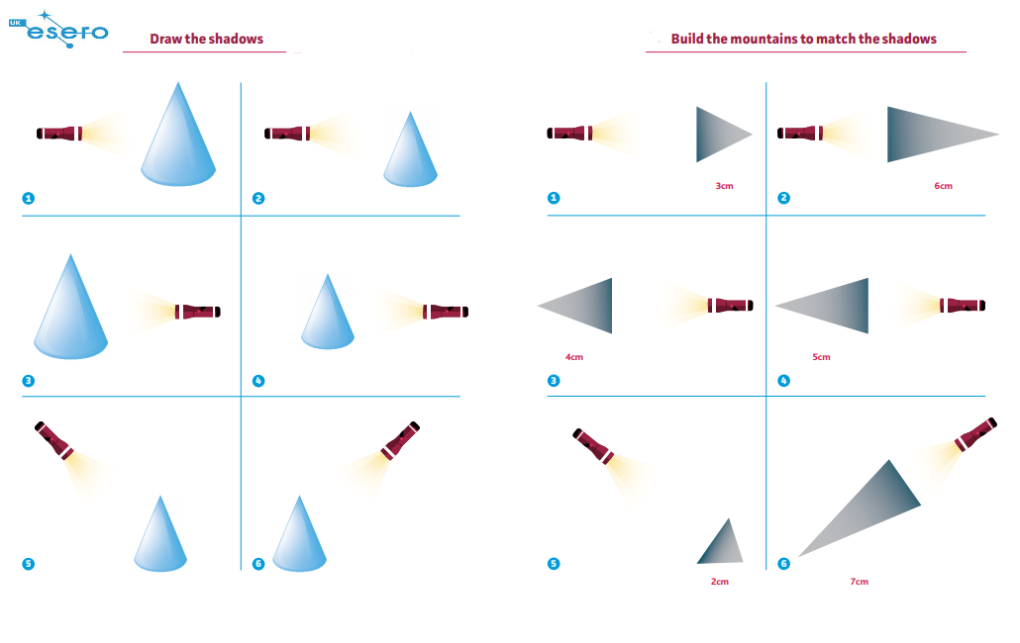
Notes:
Build mountains on a lunar surface. Learn that light from the Sun is blocked by mountains on the lunar surface producing shadows. Investigate how changing the angle of the light source and the size of the mountains affects the size of the shadows produced. Learn that astronomers can use maths to determine the height of the mountains on the Moon if they know the length of their shadow and angle of the sunlight

Slide 15


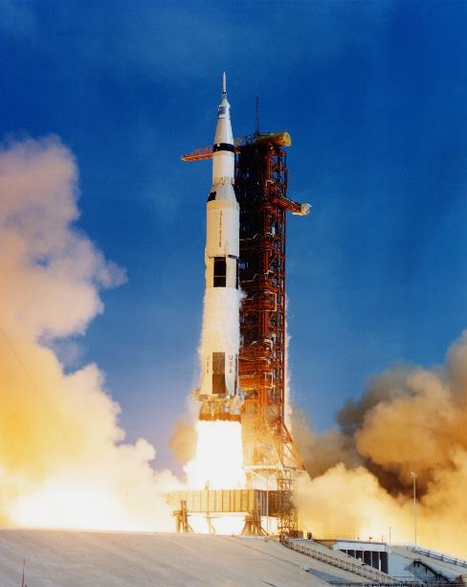
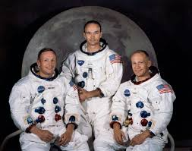


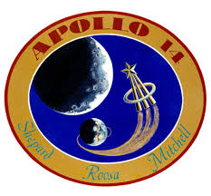

Missions to the Moon
Notes:
It took them 3 days. All 12 people that stood on the moon were American and they left 6 American Flags which have actually turned white by now, you wouldn’t be able to tell that they were American Flags – sun’s radiation so powerful on the moon that the colour would be gone. Original flag bought at a sears store which would be like walking into Dunnes Stores to buy a flag – it was only $6.
Do we still go to the moon? Not since 1972

Slide 16


Slide 17
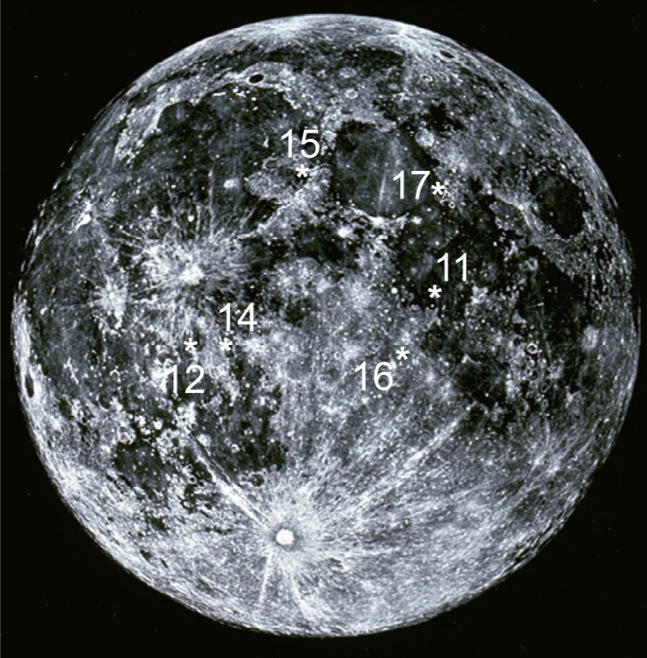
Notes:
Landing sites if the missions. Apollo 13 had to abort mission before landing on the moon – film with Tom Hanks.

Slide 18
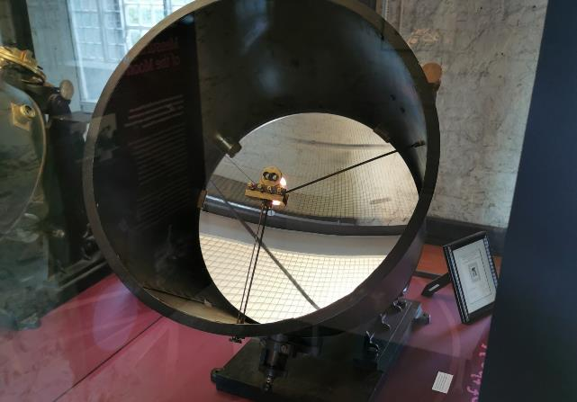
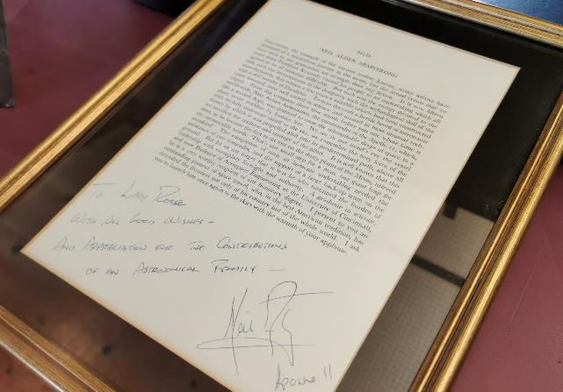
The Lunar Heat Machine at Birr Castle
Notes:
The 4th Earl of Rosse from Birr Castle was a keen Engineer, Astronomer and Mathematician. He designed the Lunar Heat Machine to work out the temperature of the moon. Attaching the machine to a telescope, he focused it on the moon and the moon’s light/energy hit the thermopiles (which can be seen attached to the middle of the mirror) creating an electrical current from which he was able to calculate the temperature. A letter from Neil Armstrong to the Parsons family, thanking them for their contributions to Space Science, can be seen in the Science Galleries at Birr Castle.

Slide 19
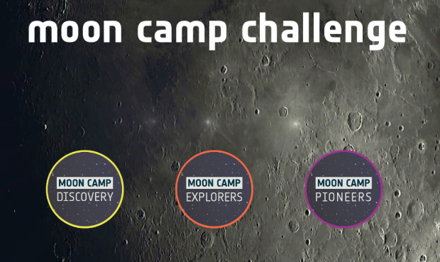
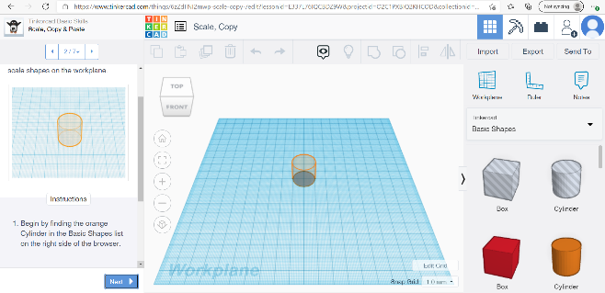

ESA - Moon Camp
Moon Camp Discovery – Moon Camp Challenge
Dashboard | Tinkercad
Notes:
Moon Camp is an education project run in collaboration between ESA and the Airbus Foundation, in partnership with Autodesk. It uses innovative learning technologies to challenge students to design their own Moon settlement with a 3D modelling tool (Tinkercad or Fusion 360).

Slide 20
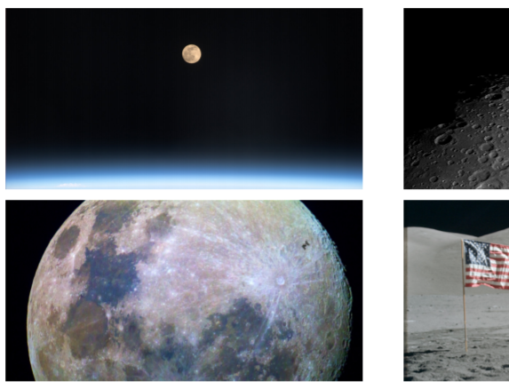
Could We Live On The Moon?
Why might we want to create a moon camp?
What would we need to bring?
What would we need to help us survive?
What challenges might we face?
Notes:
Why would we want to? Do you think the environment on Earth can be extreme? Well, space is much worse! Which hazards would astronauts come up against on the Moon? Space exploration is extremely difficult. • The environment is very harsh. • The distances are very big, even if the destination is the Moon. • Travelling to space is very expensive. Depending on the final destination, the cost per kilogram can vary from a few thousands of euros to several hundreds of thousands of euros.
ESA is working on new missions to the Moon in order to study the environment and to develop technologies, which could one day help setting up a lunar base. Perhaps astronauts will be living on the Moon in the next two decades. Space, outside of our home planet can be an extremely hostile environment for humans to live. Unlike Earth, the Moon has no atmosphere (it is in a vacuum), this means that there is no air to breathe. In addition, this lack of atmosphere leaves no protection from collisions with even the smallest meteoroids (the dust and rock debris present throughout the Solar System) or from harmful radiation from the Sun.

Slide 21
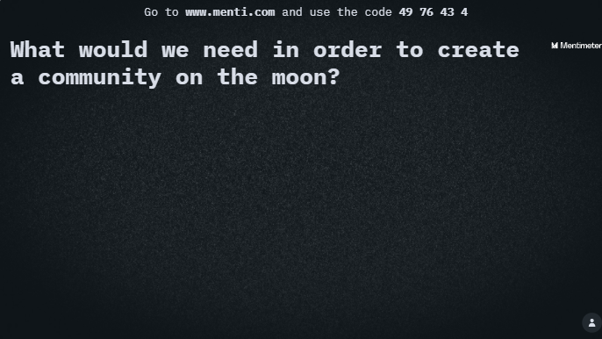
8382 9994
Notes:
Ask the children what they think might be needed to live on the moon.

Slide 22
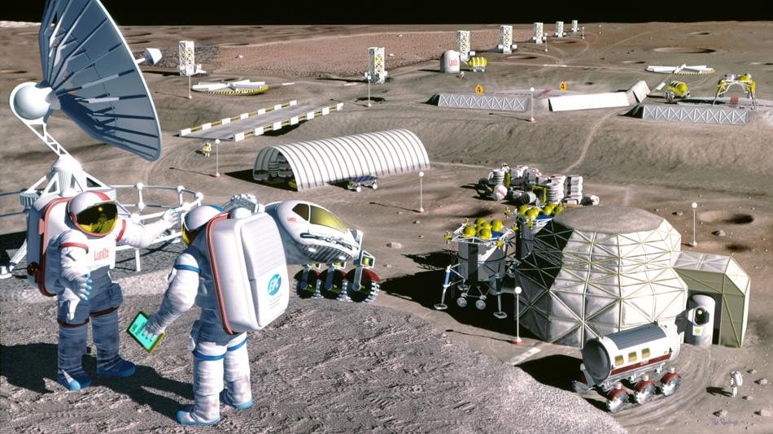
Electricity
Water Supply
Food
Waste services
Recreation
Radiation Protection
Shelter
Transportation
Communication
Exercise facilities
Warmth
Air Supply
Clothing
Notes:
Using the answers given for previous slide, springboard into a mission to the moon challenge of your own design. You can do a bit of everything or focus on juts a couple of aspects depending on your class’s interests and time contraints.
They’re hoping to have a moon camp in the next 10 years and use it as a base for future space exploration As a matter of interest wifi on the moon is better than on some parts of Earth so communications/internet won’t be a problem.
Building infrastructure on the Moon would imply taking many materials from Earth, which would be very expensive to transport. Engineers are investigating new building techniques such as 3D printing, using local materials like the lunar soil (regolith). Late 2020’s ESA and Russian Space Agency are working on creating a colony in the moon.

Slide 23
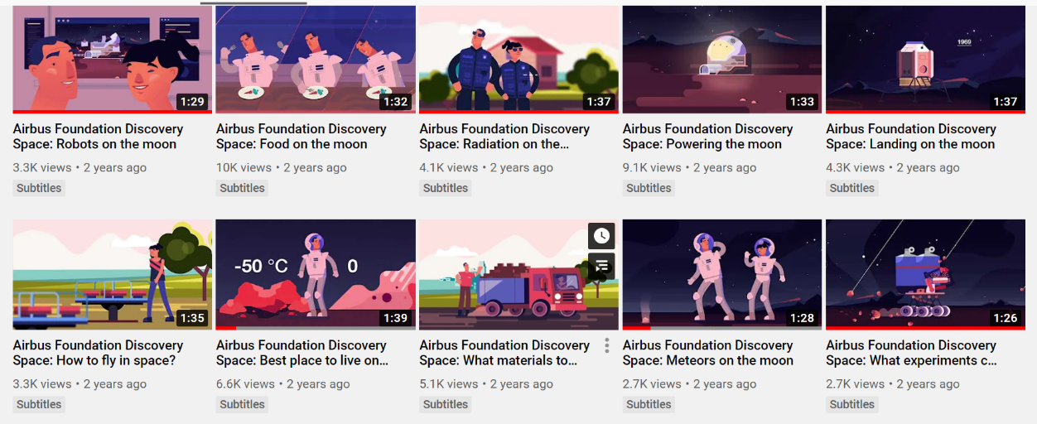
Airbus Defence and Space - YouTube
Resources – Discovery – Moon Camp Challenge
Notes:
These videos also in resources section of mooncamp challenge

Slide 24
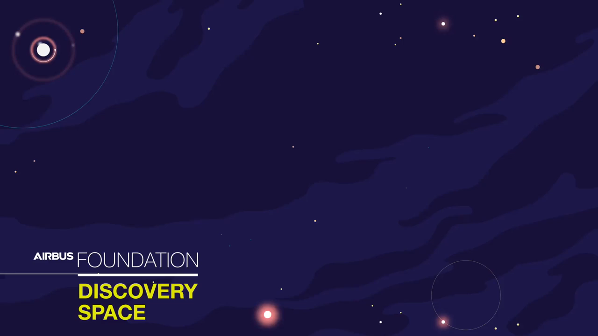

Slide 25
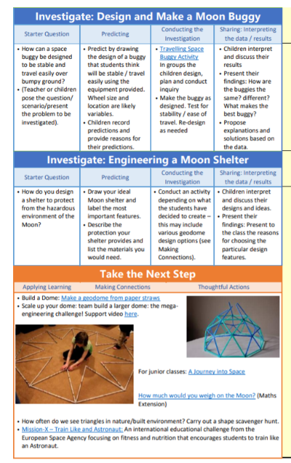
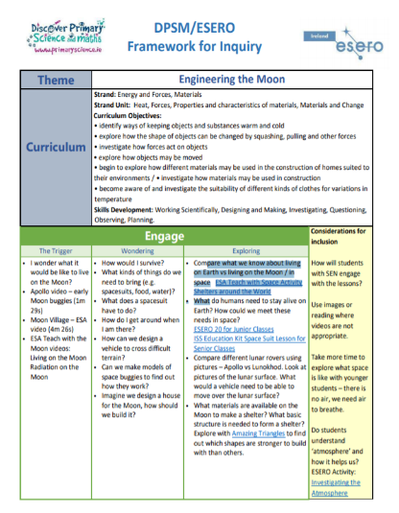
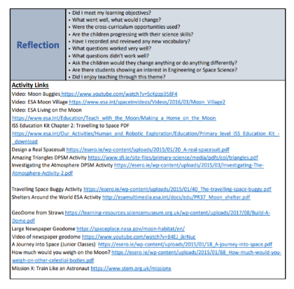
https://esero.ie/wp-content/uploads/2019/09/DPSM-ESERO-Engineers-Week-CPD.pdf
https://www.sfi.ie/resources/Our-Solar-System.pdf
Notes:
These resources are very useful for moon mission challenges. Engineering the Moon booklet has a lot of ideas and lesson plans that are workable and meaningful for the children: http://www.spaceweek.ie/wp-content/uploads/2019/09/Engineering_the_Moon.pdf

Slide 26

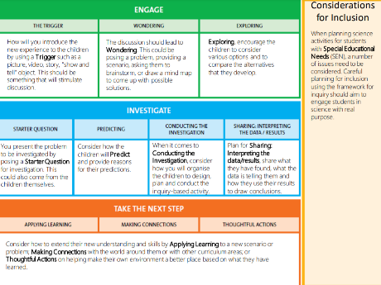
Transport
ENGAGE - Trigger
Notes:
Example for Transport as a theme.
DPSM Framework for Inquiry: TRIGGER: Transport Options on Earth. Could we use any of these on the moon?

Slide 27
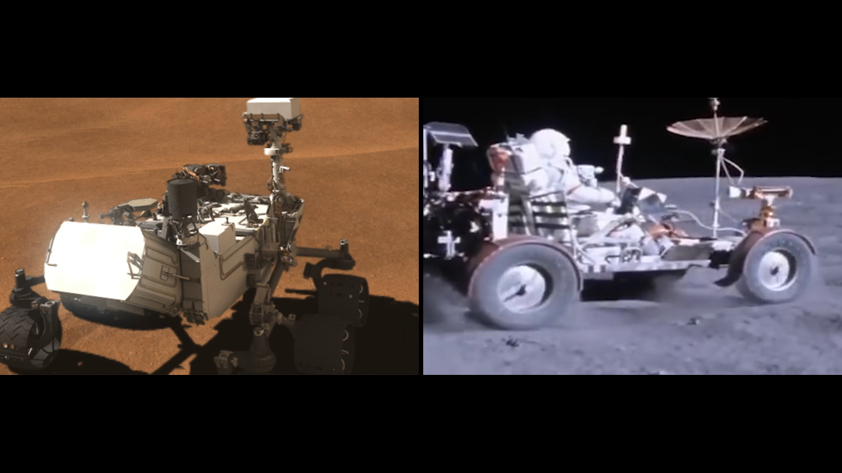
ENGAGE - Wondering
Notes:
DPSM Framework for Inquiry: Wondering
Look at how vehicles move on Mars (left) and the Moon (right) what do they notice? What will they have to take into account when making their own vehicles?

Slide 28
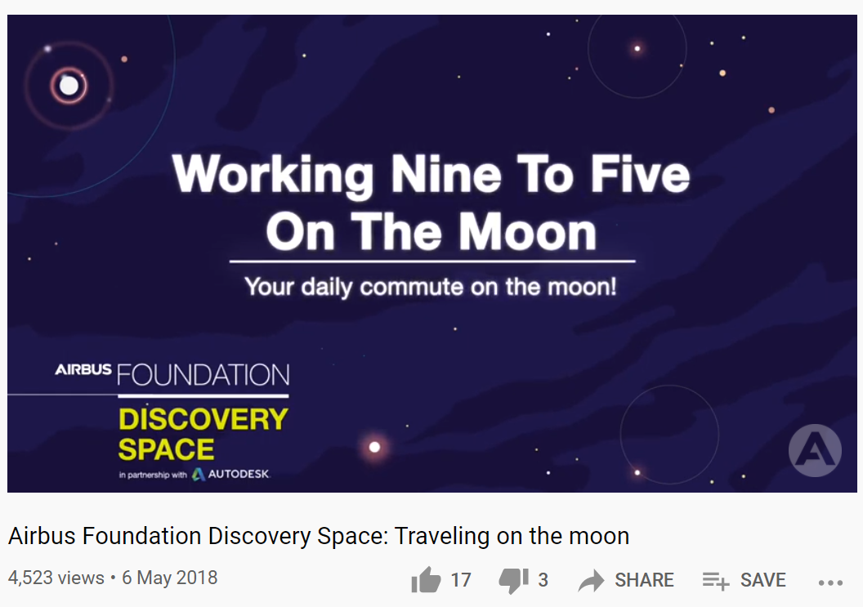
ENGAGE - Exploring
Notes:
DPSM Framework for Inquiry: Exploring
Use the Airbus Foundation videos for each them to provide more information and give focus to their inquiry.

Slide 29
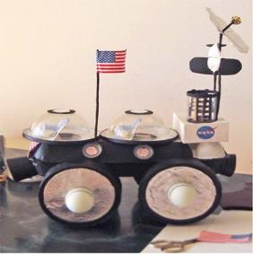
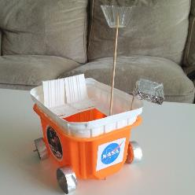
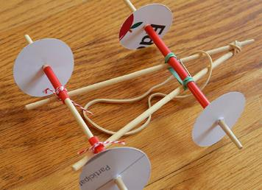
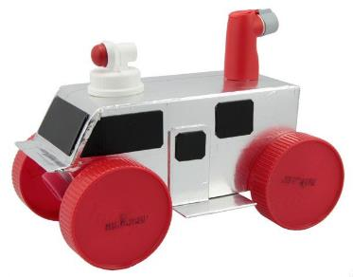
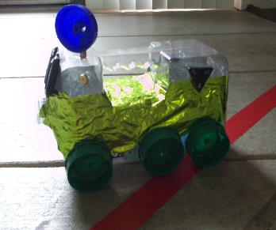
Lunar Transport
Investigate
What do you need to think about when designing a lunar vehicle?
Will it be travelling over a bumpy surface?
How will you construct the buggy?
How will you make sure the wheels can turn?
How will you make your buggy move?
Notes:
DPSM Framework for Inquiry: INVESTIGATE
Create a plan to action.

Slide 30
Mission to the Moon in your Classroom
Water Supply
Food
Waste services
Air Supply
Recreation
Exercise facilities
Radiation
Protection
Shelter
Transportation
Communication
Electricity
Warmth
Clothing
Notes:
Annotate your ideas

Slide 31




Our Moon
Lunar Phases
Synchronous Rotation
Topography
Craters
Moon Mountains
Moon Missions and Challenges
Feedback: https://forms.gle/UbtRFGXgdUomxdE69
Notes:
https://forms.gle/UbtRFGXgdUomxdE69
Summer camps are running this summer keep an eye on website. Lofar.ie

Slide 32

Questions

