Slide 1




Our Moon

Slide 2
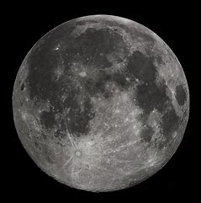
Our Moon
Lunar Phases
Synchronous Rotation
Topography
Craters
Moon Mountains
Moon Missions and Challenges
Notes:
As a result of this session, you will have a good understanding of the above lunar subject areas, will know how to incorporate them into your teaching of the SESE curriculum and have an array of interactive activities and inquiry led investigations to apply to the learning objective. There are also links to a number of focused online resources that will assist in your teaching of this subject area.

Slide 3

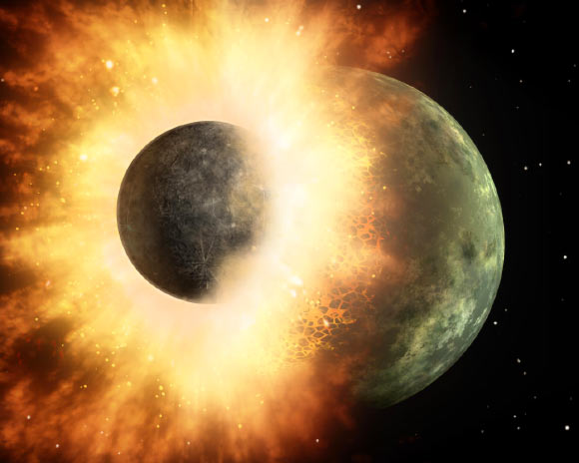
Our Moon
Notes:
The moon rocks were analysed and found to be mostly of the same stuff that the Earth is made of. The moon is 40 million years younger – it formed after the Earth. The moon also spins. When things spin in space, there needs to have been something that caused it. The angular momentum (spin) of the moon was widely regarded to have been caused by a collision. Another planet roughly the size of Mars gave Earth a glancing blow that knocked off the upper surface but not the iron core of Earth and gave spin. We have a good idea about this because of the moon missions that provided us with moon rocks that could be dated and analysed.

Slide 4
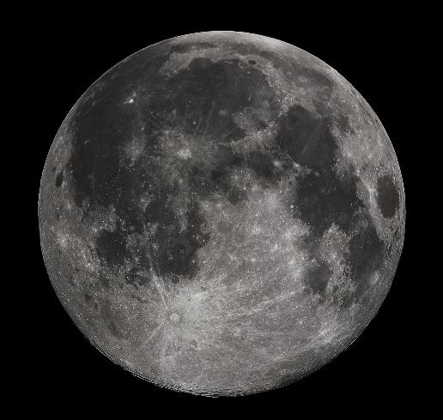
Our Moon
x400 smaller in diameter than the Sun
x400 closer to Earth than the Sun
It reflects the light of the Sun
We only see one face
Earth’s only natural satellite
Gravity is only about 17% as strong as gravity on Earth.
It’s one of the biggest moons in the Solar System and by far the biggest in comparison to its planet
Notes:
Because the moon is so large compared to planet, some people think it might be a binary planet rather than simply a moon. You could fit 50 moons inside our Earth. It is our natural satellite. It has a very thin atmosphere called an exosphere. If you were on an aeroplane, it would take 26 days to get there, but light travels the same distance in just one second. There are moonquakes in the same way that we get earthquakes caused by tidal forces from Earth. The moon is moving away from our planet by 5cm a year. When it was created it was only 30,000 kilometers away – now it is 380,000km. In about a million years the solar eclipse won’t be the same as it is now. Our moon is at the magic number of being 400 x smaller than the Sun and 400x closer to Earth than the sun currently, enabling the perfect eclipse. The sky would always look black from the moon because there is now atmosphere to refract the light. No sound on the surface of the moon as it has no atmosphere. You would weigh 6x less. Every human that has ever lived has looked up at the night sky and seen that one side shining back at us. People in folklore have often seen animals in the moon. Gallileo Gallili was the first to train a telescope on the moon and saw mountains and valleys. Some of the craters are 4 billion years old!
There is frozen water at poles and inside the deepest craters
Our moon is the 5th biggest moon in our solar system
One day on the Moon lasts for 27.3 Earth days; of this there are 14 days of daytime, followed by 14 days of nighttime. The temperature variation between day and night is extreme. The temperature can be as high as +123 o C and as low as -233 o C, depending on the location.
The sunny side is hotter than boiling water, the dark side colder than any place on Earth
The heaviest elements like iron in the moon have sunk into its centre, lighter elements have risen to the surface.
The light areas of the Moon are known as the highlands, the dark features, called maria (Latin for seas), are impact basins that were filled with lava between 4.2 and 1.2 billion years ago.
The moon’s large dark spots are known as lunar maria, which is Latin for moon seas. Unlike our seas on Earth full of water, the seas on the moon were full of molten lava. Impact craters can also clearly be seen.

Slide 5
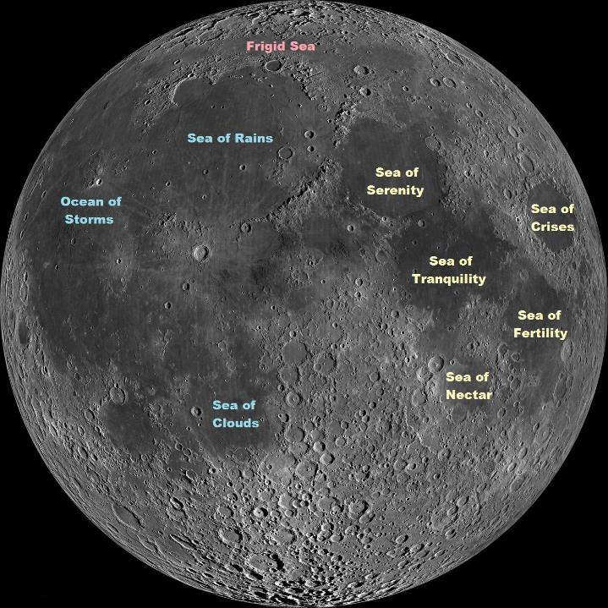
Notes:
Most features on the moon have been given names

Slide 6
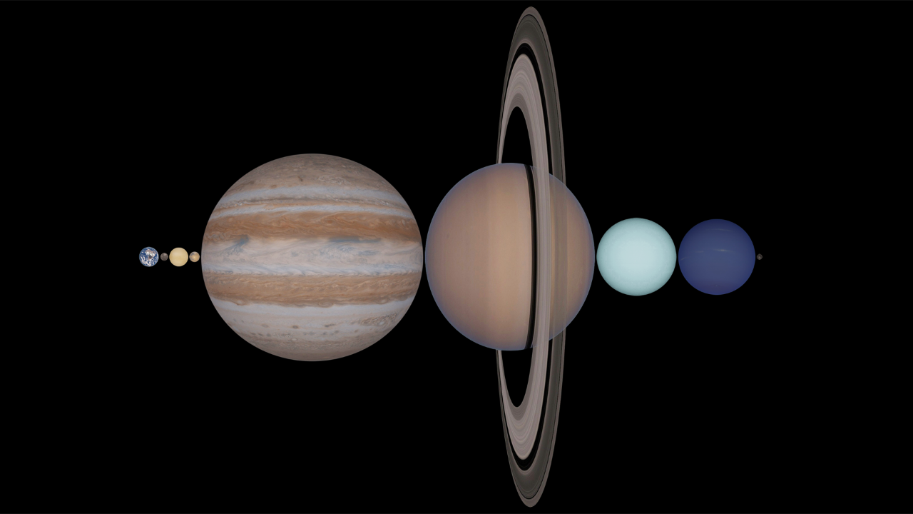
Earth
Earth’s Moon
Notes:
The moon is further away than you might think. Some of the artistic impressions are quite misleading. The moon and Earth are on average 384,400km apart and this distance is increasing by 5cm annually. You can fit every planet in the solar system in the space between the Earth and the moon (as long as Saturn sits sideways!)

Slide 7
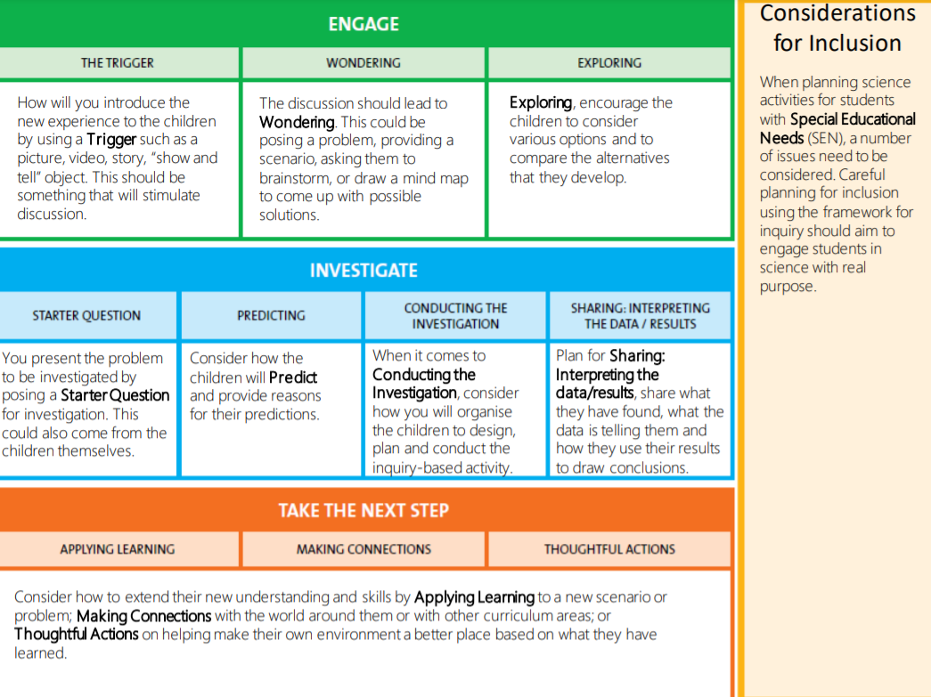

Discover Primary Science and Maths | Science Foundation Ireland (sfi.ie)
Notes:
DPSM/esero Framework for Inquiry. Stages of planning for inquiry based learning: Engage. Investigate. Next Step. Reflect.
https://www.sfi.ie/engagement/discover-primary-science-and-maths/

Slide 8
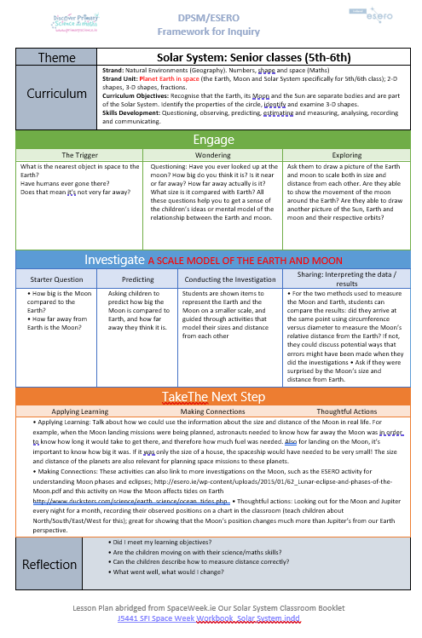
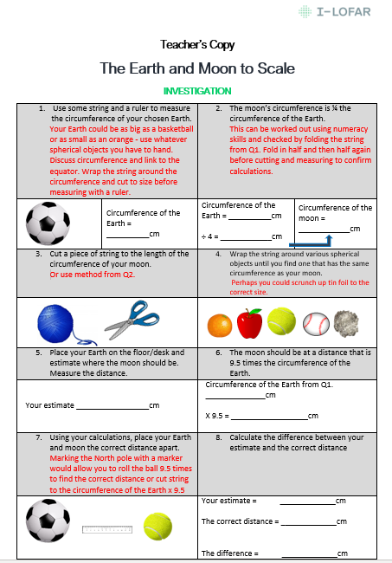
www.spaceweek.ie/wp-content/uploads/2017/07/Classroom-Resource-Booklet-Our-Solar-System.
Notes:
Excellent resources available here: https://www.spaceweek.ie/wp-content/uploads/2017/07/Classroom-Resource-Booklet-Our-Solar-System.pdf

Slide 9


Slide 10
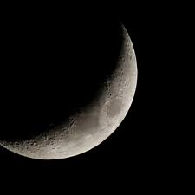
Lunar Phases
Notes:
The moon looks different to us at different times of the month. This activity explores why.

Slide 11
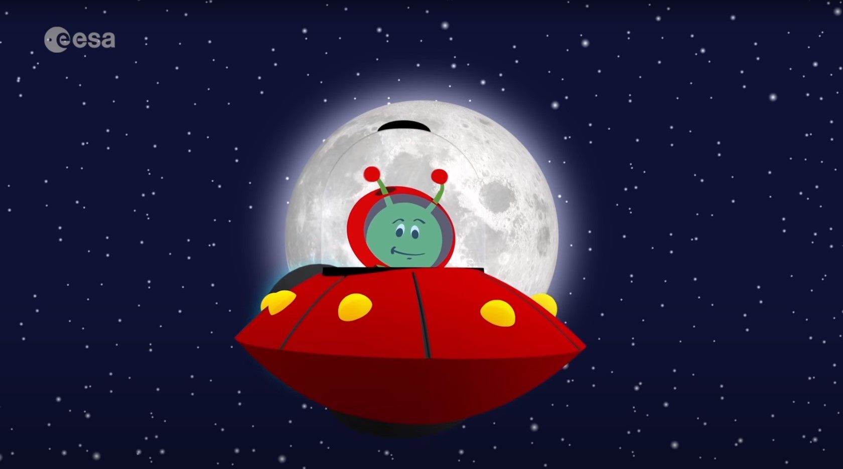
Paxi and Our Moon: Phases and Eclipses
Notes:
Trigger: Paxi and the moon (https://www.youtube.com/watch?v=w4U_cuF-_hI) – Paxi is the ESA mascot
Esero European Space Education Resource Office - Home | ESERO | European Space Education Resource Office
Keywords: Satellite, Orbit, Northern/Southern Hemisphere, Eclipse

Slide 12
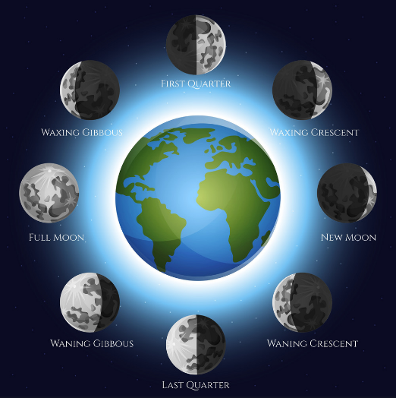
Phases
The different shapes come from the way the Sun illuminates the Moon and how much of that illumination we can see from Earth
Notes:
The image shows how the moon looks to us from the Earth. The image was taken straight from the internet, but isn’t correct. Seeing the error helps us to explain what the phases should actually look like. The light on the surface of the moon from New Moon up to Waxing Crescent, First Quarter is increasing from left to right, The Waxing Gibbous should follow this pattern and ¾ of the moon should be lit on the right hand side with a sliver of dark on the left – the exact opposite of what is pictured here. Waxing = become larger. Waning = become smaller

Slide 13


Slide 14
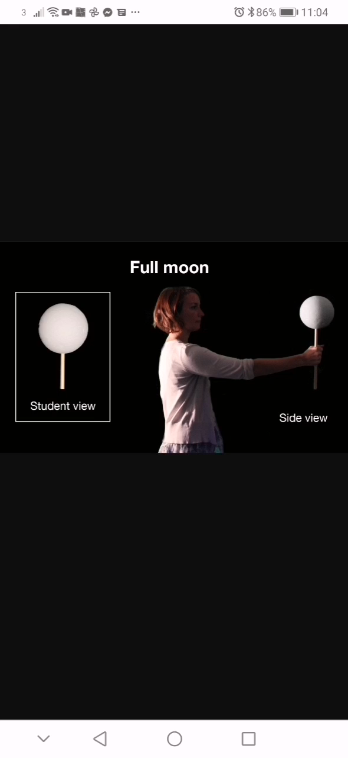
Notes:
https://www.jpl.nasa.gov/edu/images/activities/moonphases.gif
Ask the children to predict where the light is coming from/position of the sun in this video. How do they know?

Slide 15
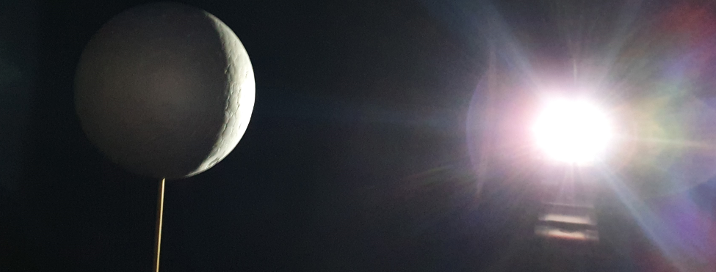
Investigation
Notes:
Using the lamp/ball activity, can the children replicate and name the moons in the picture? Perhaps using a torch and an orange on a stick?

Slide 16
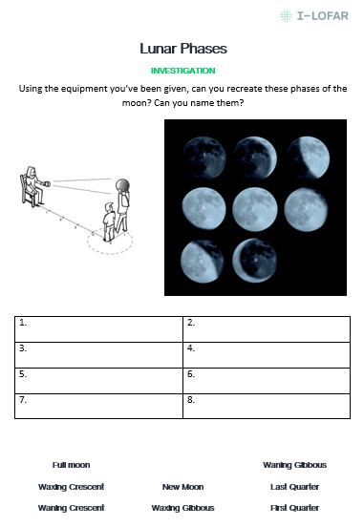
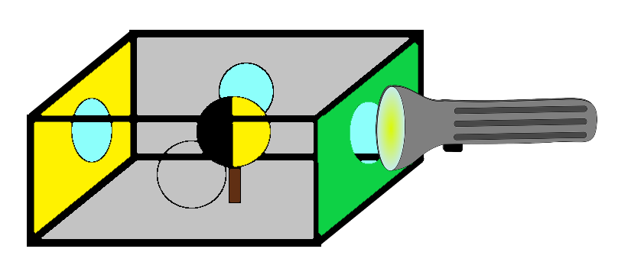
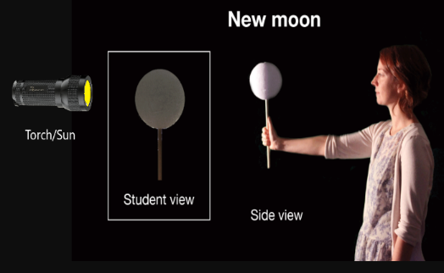
Notes:
Worksheet options. There are three worksheets for the active investigation with the top left image being replaced with the other images you see here according to your preferred method.

Slide 17
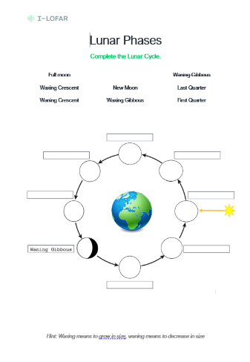
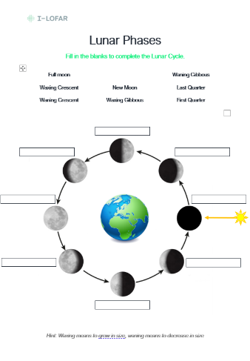
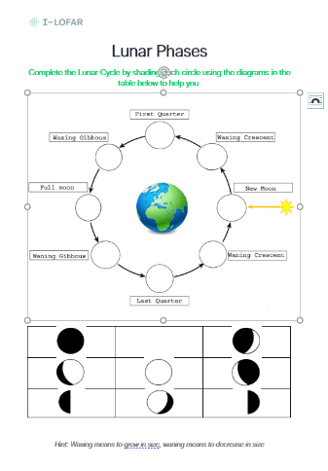
Notes:
Differentiated alternative worksheets for lunar phases.

Slide 18
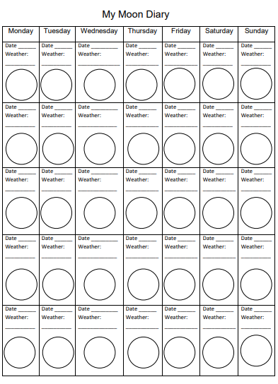
Notes:
Asking the children to observe the moon every night for a month and draw its appearance, helps to reinforce their learning.

Slide 19
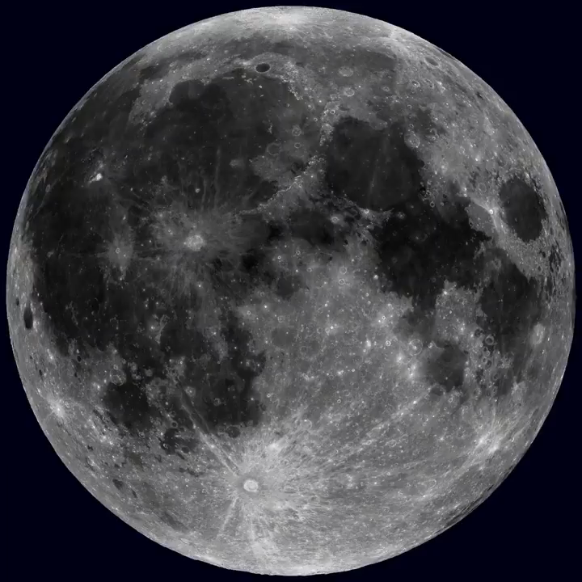
Synchronous Rotation
Notes:
Does the moon spin or does it remain fixed on its axis as it orbits the Earth?

Slide 20
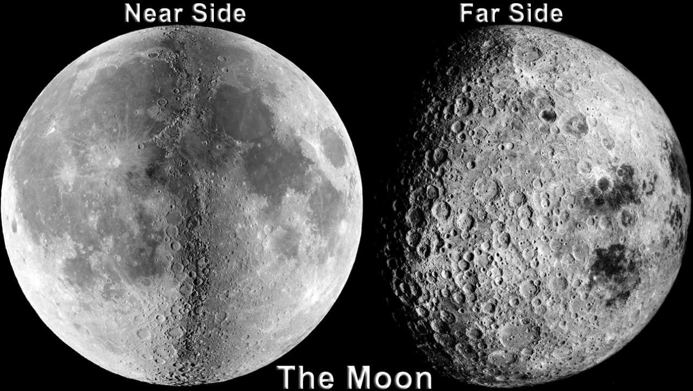
Notes:
We only see one side of the moon from Earth – the Near Side. From our lunar phases activity, we know there is actually no Dark Side of the moon as all faces are lit at some stage during the month even if we can’t see that from Earth. Dark really means unknown. The correct name for the opposite side of the moon to us is the Far Side and it was first observed in 1959 when it was photographed by the Soviet Luna 3 space probe. The Near and Far side look markedly different with more maria on the Near and more craters on the Far. One commonly accepted explanation for this difference is related to a higher concentration of heat-producing elements on the near-side hemisphere while other factors, such as surface elevation and crustal thickness, could also affect where basalts erupt,

Slide 21
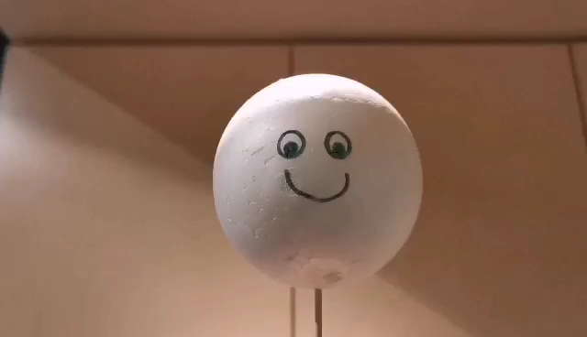
Notes:
Activity. The same side of the moon faces the Earth throughout its orbit. Is the moon spinning on its axis or not? Investigate.

Slide 22
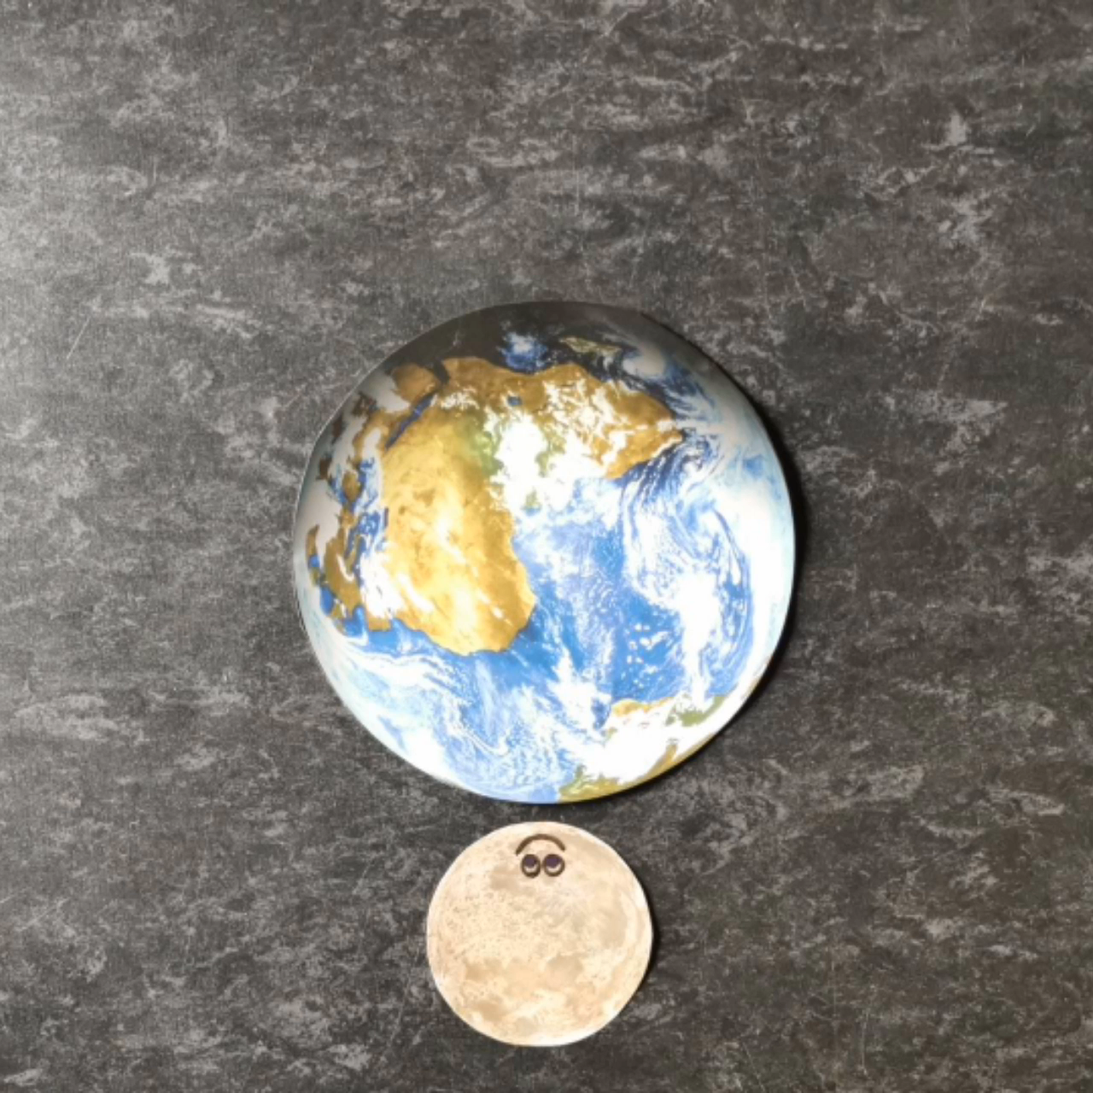

No rotation: all sides of the moon would be visible from Earth at some point during its orbital period.
Rotation: we only see one face of the moon from Earth throughout its orbital period.
Notes:
Look at video on following slide for information. Stop Motion Studio was the free app used for this video.
Creating a stop motion video is a great way to demonstrate exactly how the moon moves around the Earth., If there are tablets in the school, the children could replicate this video and investigate for themselves. Fix the camera above the Earth and moon, and move/draw on wipeboard the moon in increments taking a photo at regular intervals (5cm each time is good) – first with its smiley face always facing the same direction and then always facing Earth. What do they notice?
Another explainer video: https://youtu.be/qdOHRttkKLE

