Slide 1








Radio Astronomy in Birr
lofar.ie @LOFARireland
Notes:
Radio Astronomy in Birr with I-LOFAR

Slide 2

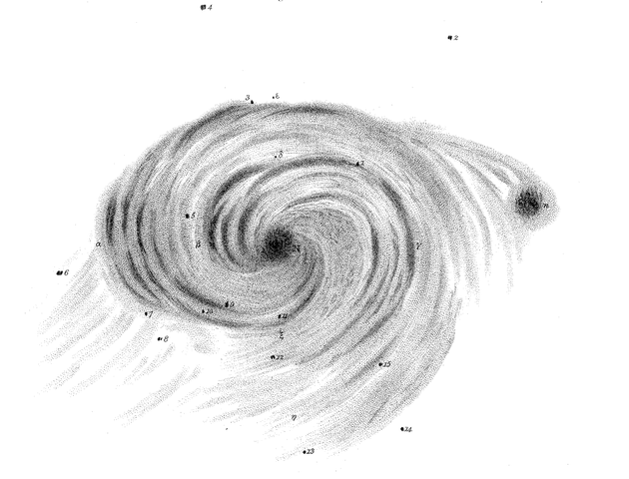
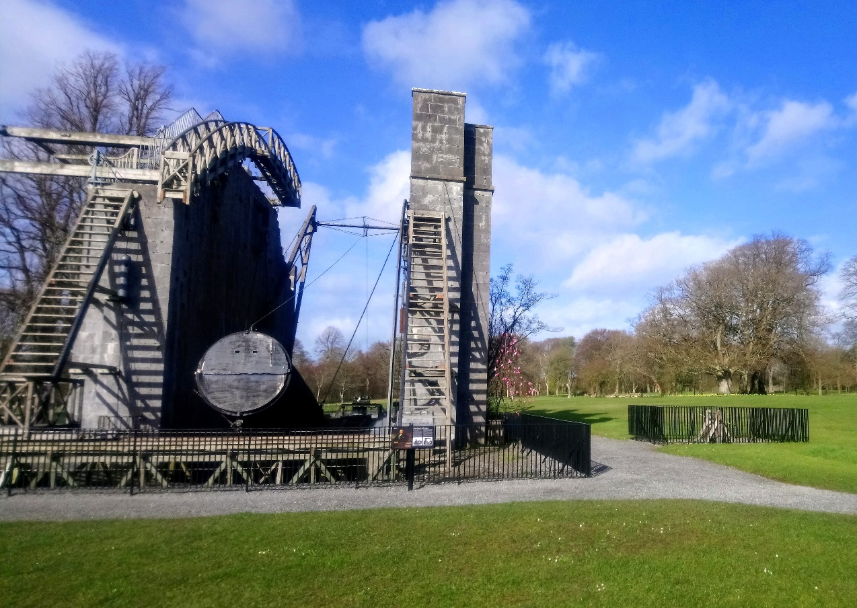
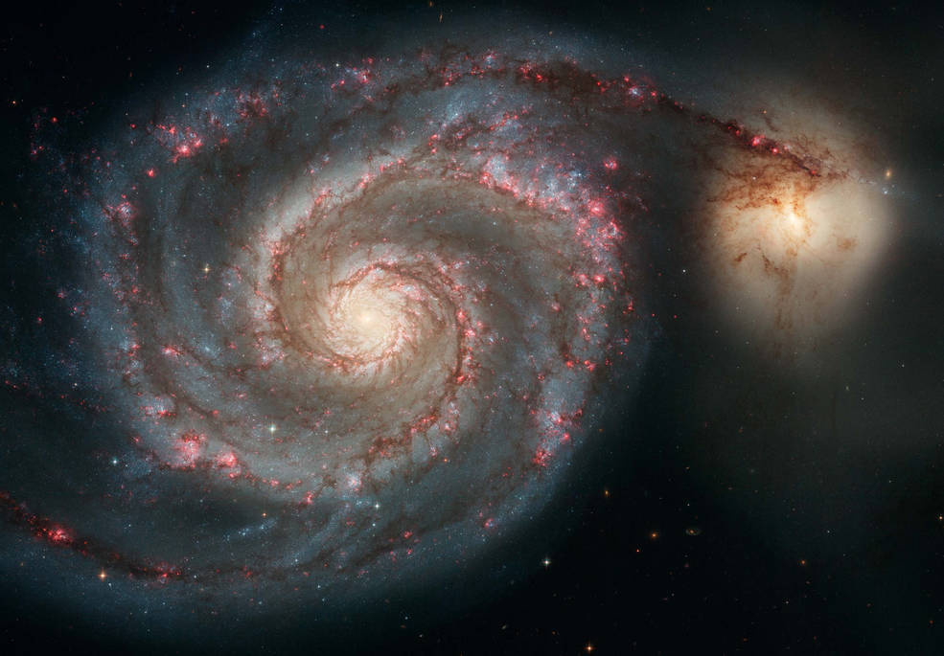
Astronomy at
Birr Castle
Spiral nature of nebula M51 observed in 1845
The Leviathan Telescope at Birr Castle Demesne
Whirlpool Galaxy (M51) photographed by Hubble 2005
Notes:
Astronomy at Birr Castle
There is a long and rich history of astronomy research at Birr.
The Leviathan Telescope
- Completed in 1845 it was the largest telescope in the world for over 70 years
- Built at Birr Castle by the 3rd Earl of Rosse
- Was the first to clearly see the spiral structure of M51, named the Whirlpool Nebula, now known to be the Whirlpool Galaxy
- This was the first time the spiral nature of galaxies was observed. We now know many galaxies have this spiral structure, including our own Milky Way Galaxy.

Slide 3

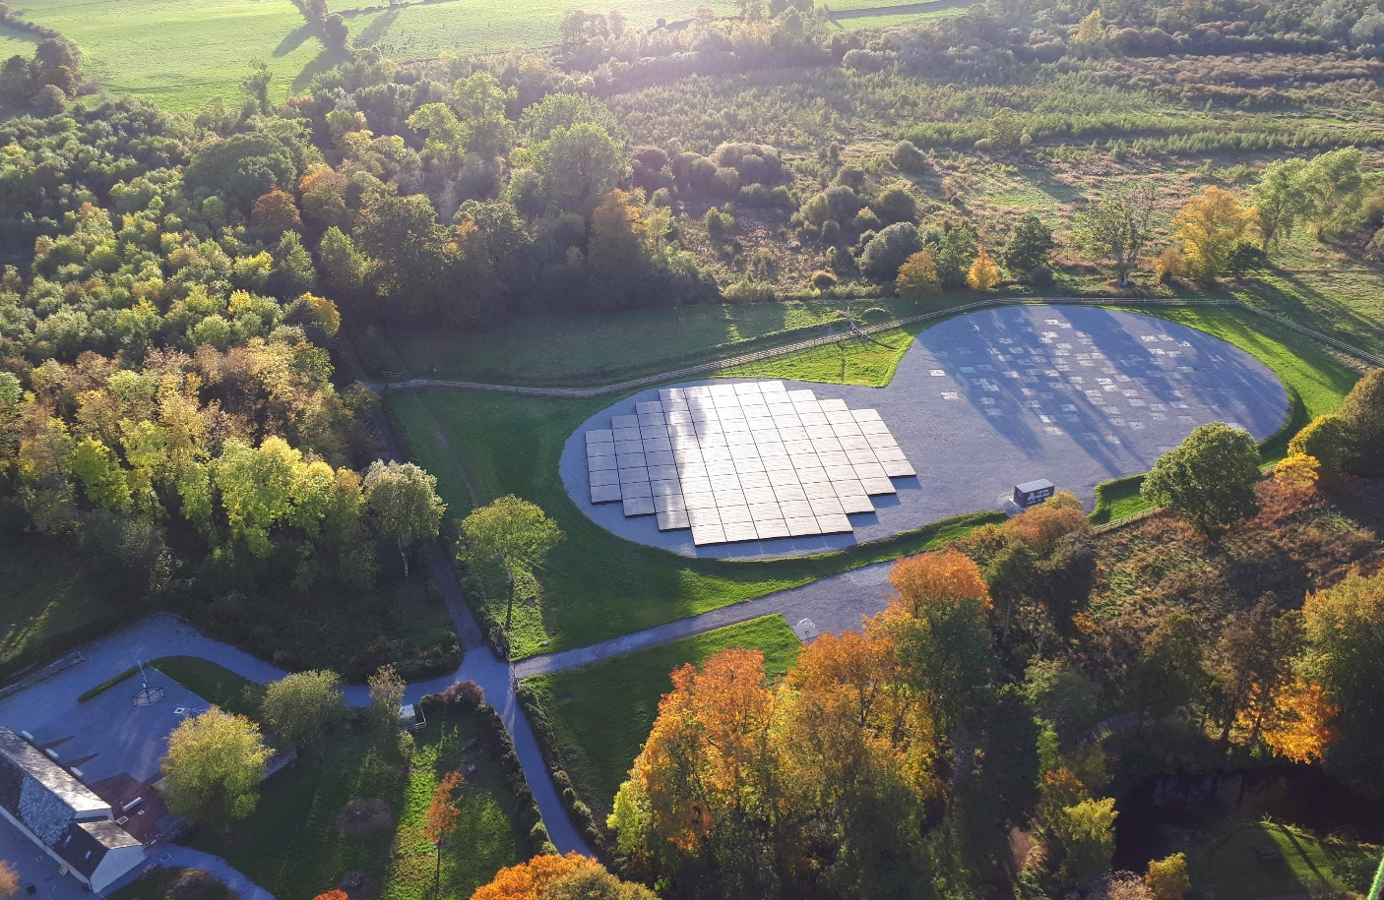
Leviathan Telescope
I-LOFAR
Credit: Alison Delaney, Birr Castle
Notes:
Past to Present
Astronomy research continues at Birr today with I-LOFAR.
I-LOFAR is the Irish Low Frequency Array, one station in the International LOFAR Telescope which is spread across Europe and is the largest low frequency radio telescope in the world.

Slide 4
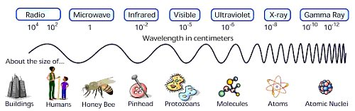
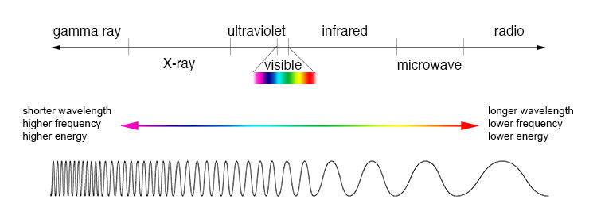
What is Radio Astronomy?
Collecting radio waves, a form of Electromagnetic radiation, from space, using a radio telescope.
Notes:
But what is a Radio Telescope?
First of all, what is radio astronomy? It is where we look at light coming from space which is different to visible light.
Looking at the Electromagnetic Spectrum, there are many different types of light which we cannot see, including X-ray light, infrared light, and of course radio light, but we can build machines which can detect and see this light – like a radio telescope.

Slide 5
What is Radio Astronomy?
Collecting radio waves, a form of Electromagnetic radiation, from space, using a radio telescope.
Notes:
The different types of light along the electromagnetic spectrum have different wavelengths and frequencies.
The higher energy light such as x-rays and gamma rays have a higher frequencies but shorter wavelengths.
On the other end of the spectrum, the lower energy light such as radio have lower frequencies but longer wavelengths.
I-LOFAR observes radio light with wavelengths about the height of people, around one or two metres.

Slide 6
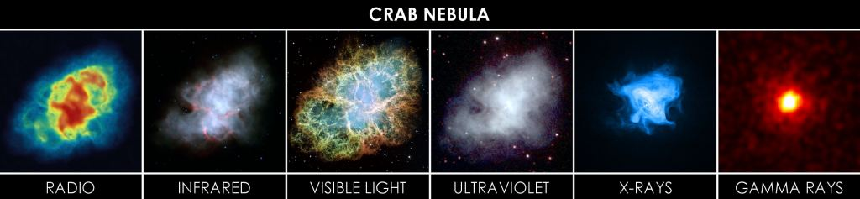
What is Radio Astronomy?
Notes:
Why do we bother looking at different types of light coming from space? We can already see the sun and stars in visible light, so what’s the point?
By collecting all the various types of radiation a clearer image of celestial bodies and phenomena can be created.
In this example of the Crab Nebula (also observed and first named at Birr Castle in the 19th century), we can see a lot more detail and information about what is going on by looking at the different frequencies.
It is like we can see different ‘layers’ of the object and better understand what is happening.

Slide 7
RFI - Radio Frequency Interference
Light pollution makes it difficult to see the stars at night.
There are radio waves that interfere with scientific observations.
It comes from radio stations, but also different electrical devices and equipment that produce signals.
Notes:
What is RFI?
We are all familiar with light pollution – if you try to look at the stars while standing under a street light you will not be able to see the stars!
This is because although the stars are much brighter than the street light, they are much further away, so the street light beside you drowns their light out.
The same thing occurs at radio frequencies and is called Radio Frequency Interference (RFI).
The radio signals coming from terrestrial radio stations, as well as those often emitted by electrical devices, are much closer and can block out the weak radio signals coming from space.
So for radio astronomy, we need to find somewhere with less RFI.

Slide 8
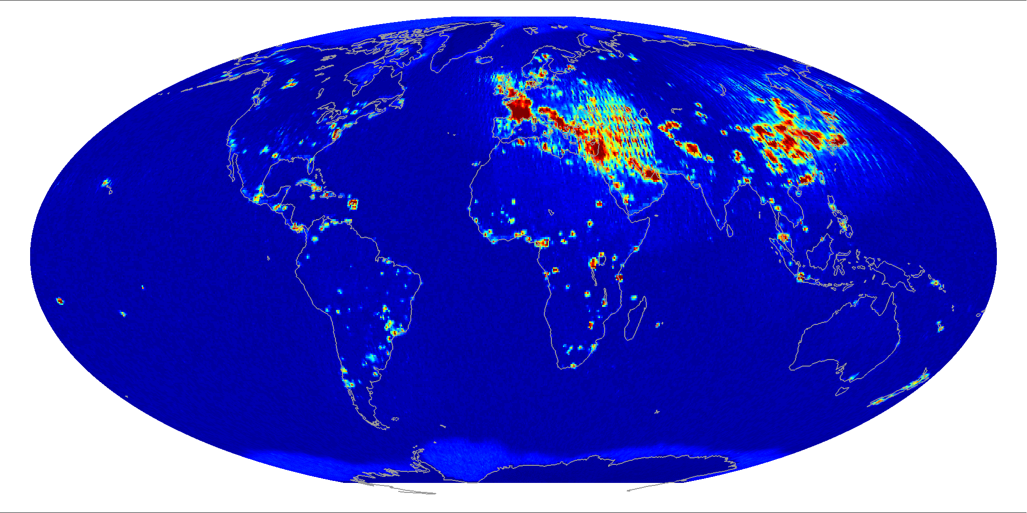
Notes:
This map shows some of the radio signals which would cause RFI.
This is not complete as only some frequencies are shown.

Slide 9
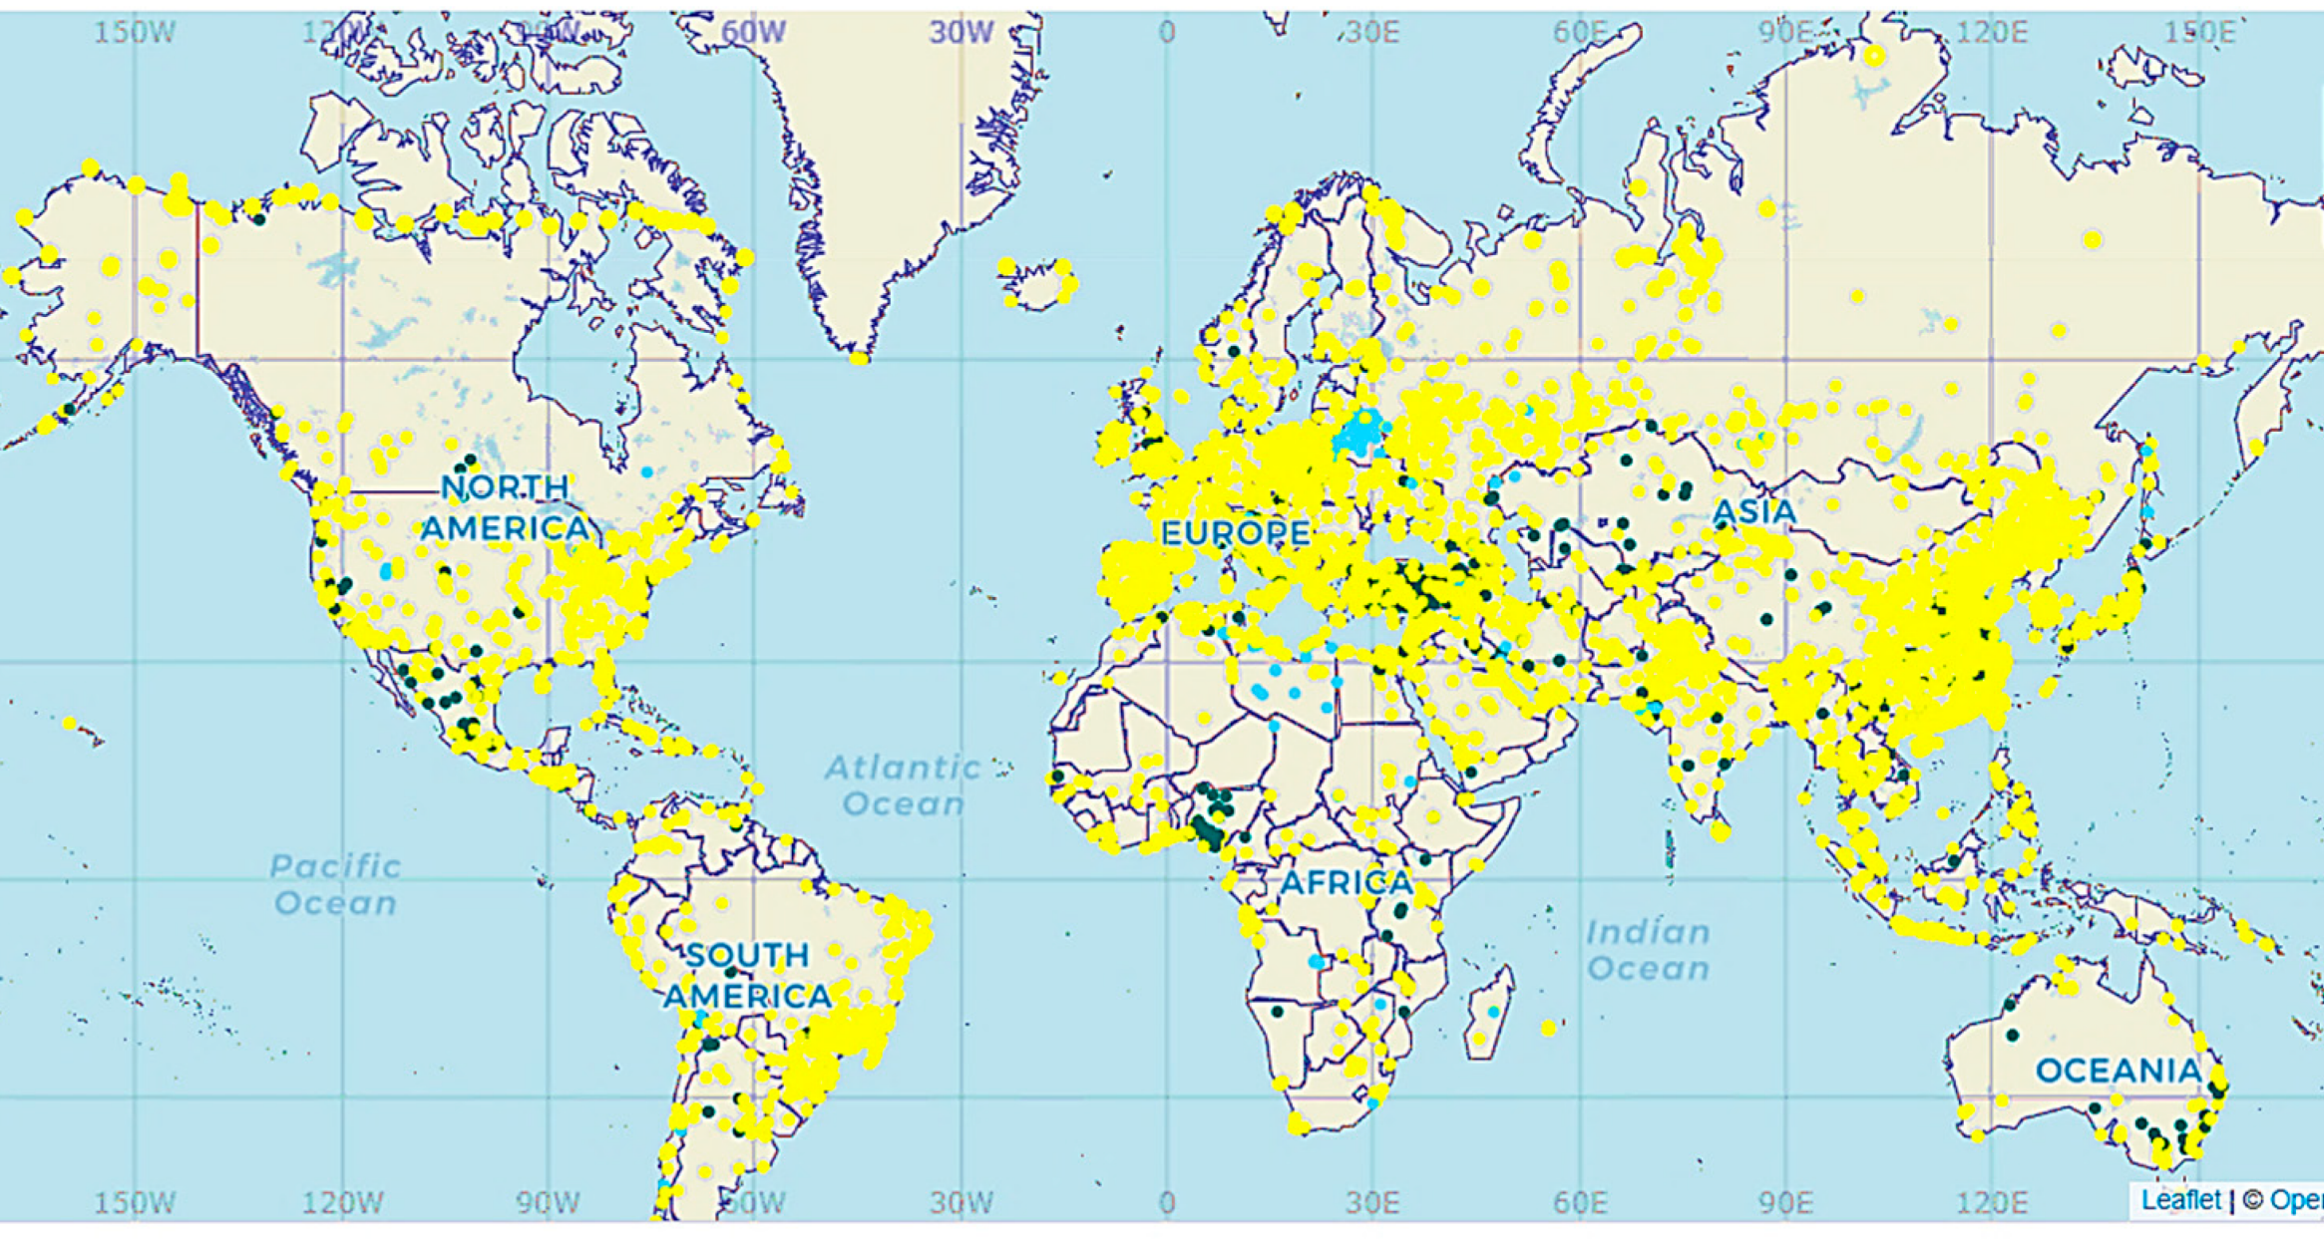
Notes:
This map also shows some of the radio signals which would cause RFI.
As previously, this is not complete as only some frequencies are shown.

Slide 10
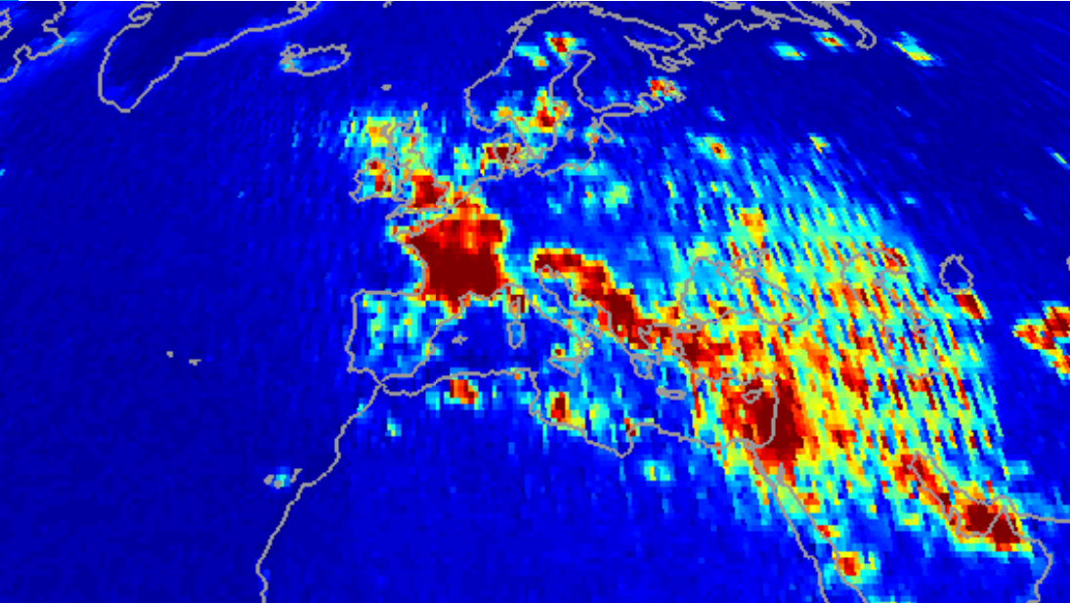
Notes:
Taking this example, we zoom in on Europe to see where there is more and less RFI to determine a good place to locate a radio telescope.

Slide 11
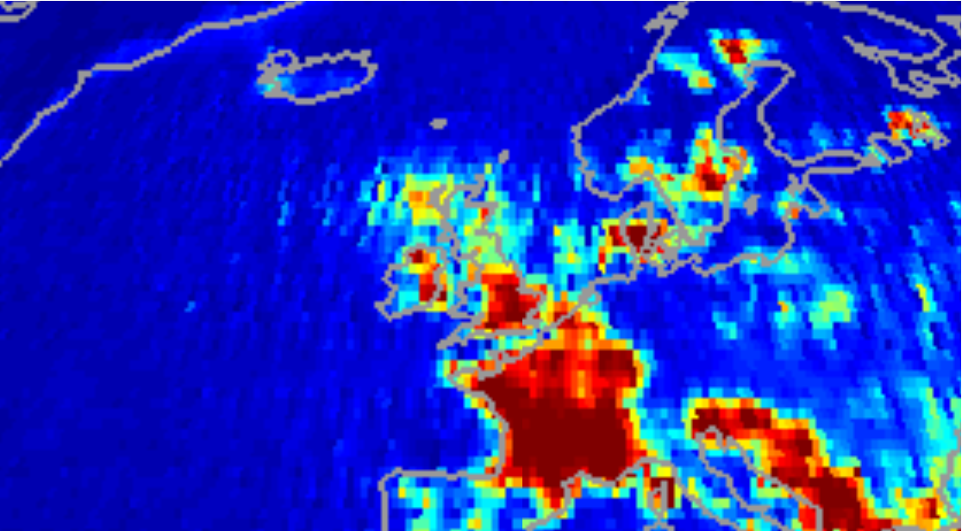

Slide 12
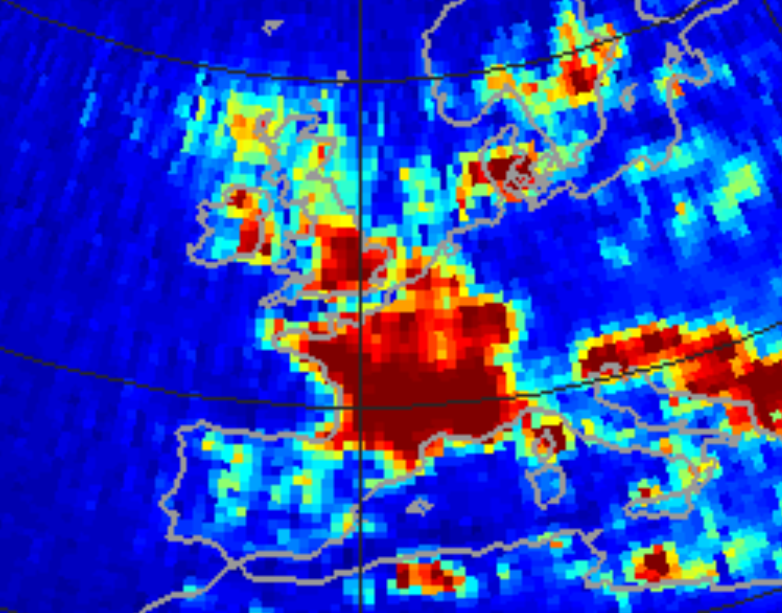
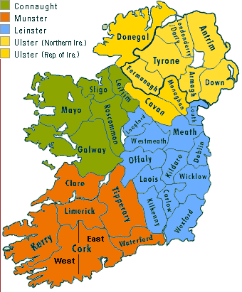
Where would you put a radio telescope in Ireland?
Notes:
Focusing on Ireland, where is a good location for a radio telescope given the information on this map?
Common suggestions here would be midlands, west and south west coasts.
But it is also important to take other factors into account;
- accessibility of location for building and maintenance and availability of space (radio telescopes are big!).
- any major flight paths overhead, as large airplanes cause RFI with their electrical equipment, and also can reflect ground based RFI back increasing the effect.
The midlands is the most suitable across all these requirements, as it is easy to get to – around equal distances from many of the main research institutes (Galway, Dublin, Cork, etc), no major flight paths overhead, and in an area of low RFI.

Slide 13


Birr is the Best Place in Ireland!*
*for Radio Astronomy
Notes:
What we like to say ☺

Slide 14
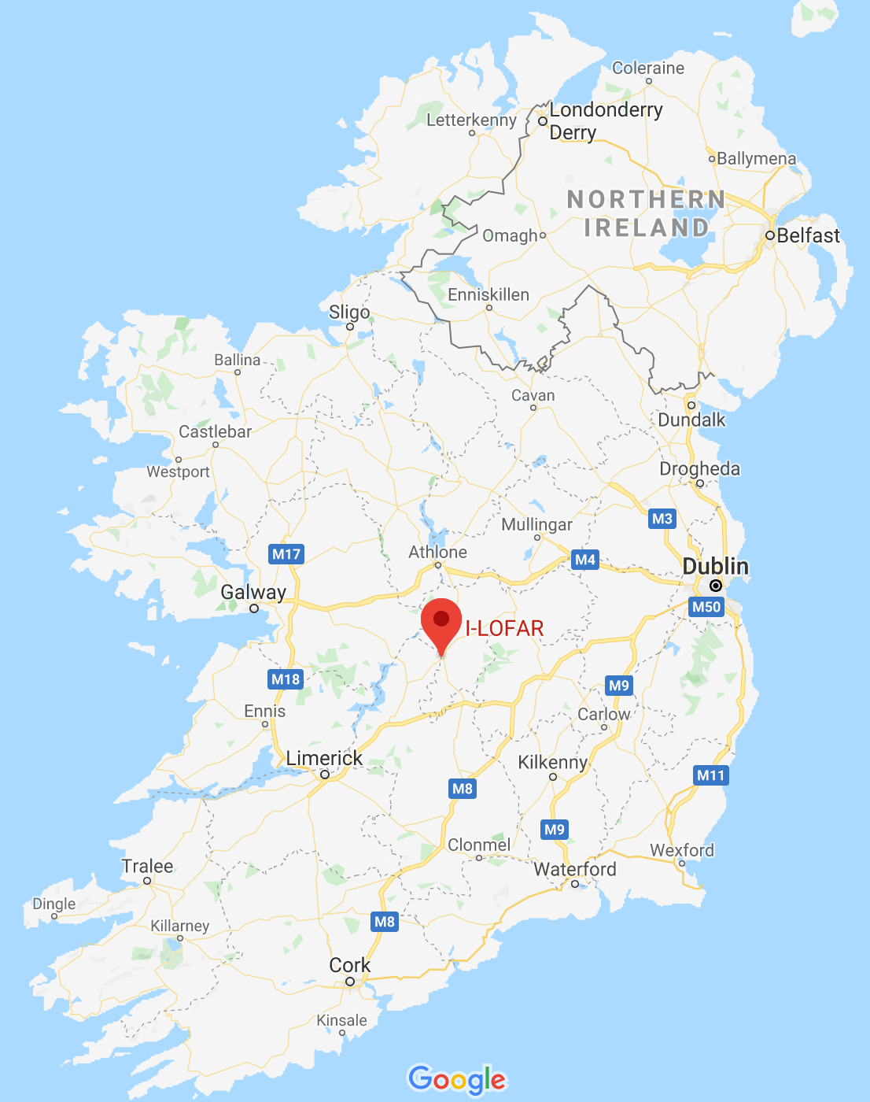
Why Birr?
Low RFI levels
Centre of Ireland – accessible
Great history of astronomy research in Birr
Links up across Europe to create the International LOFAR Telescope
Notes:
As we have seen, there are low RFI levels in the region.
It is also very easily accessible for construction and ongoing maintenance.
There are no major flight paths overhead causing more interference.
It also has historic links to cutting edge astronomical research which is great to continue and highlight the scientific relevance of the area.

Slide 15

I-LOFAR
Credit: Alison Delaney, Birr Castle
International LOFAR telescope
Notes:
These other telescopes are spread throughout Europe.
I-LOFAR links up with the other LOFAR stations in the International LOFAR Telescope making the equivalent of a Europe sized telescope.

Slide 16
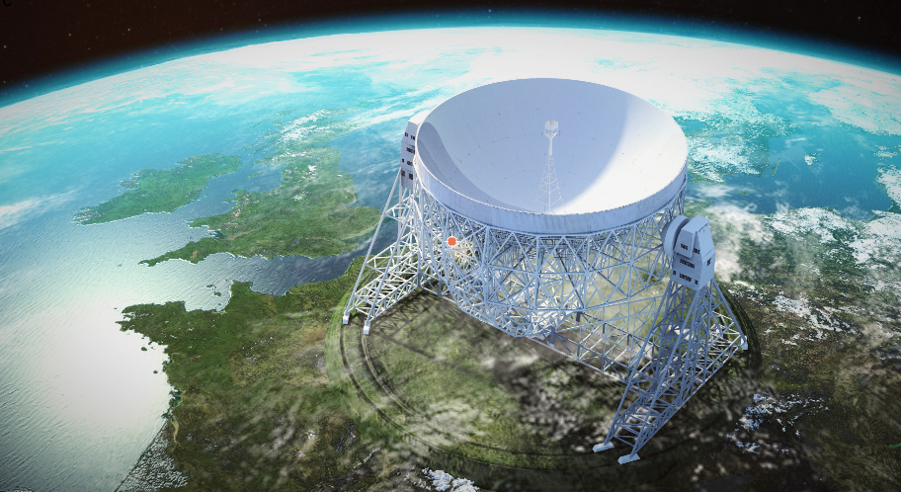
Notes:
With the entire network it is as if there is a large telescope stretching all across Europe.
*Not a real photo!

Slide 17
What happens at I-LOFAR?
Two types of antenna
Data can be collected all day everyday
Low band antennae
High band antennae
Notes:
How does I-LOFAR work?
There are two types of antenna, low band antennae (LBA) and high band antennae (HBA)
There are 96 tiles for each
- the LBA have two antennas per tile with a total of 192 antennas
- each HBA tile contains 16 smaller squares, each with two antennas, giving a total of 3,072 antennas

Slide 18
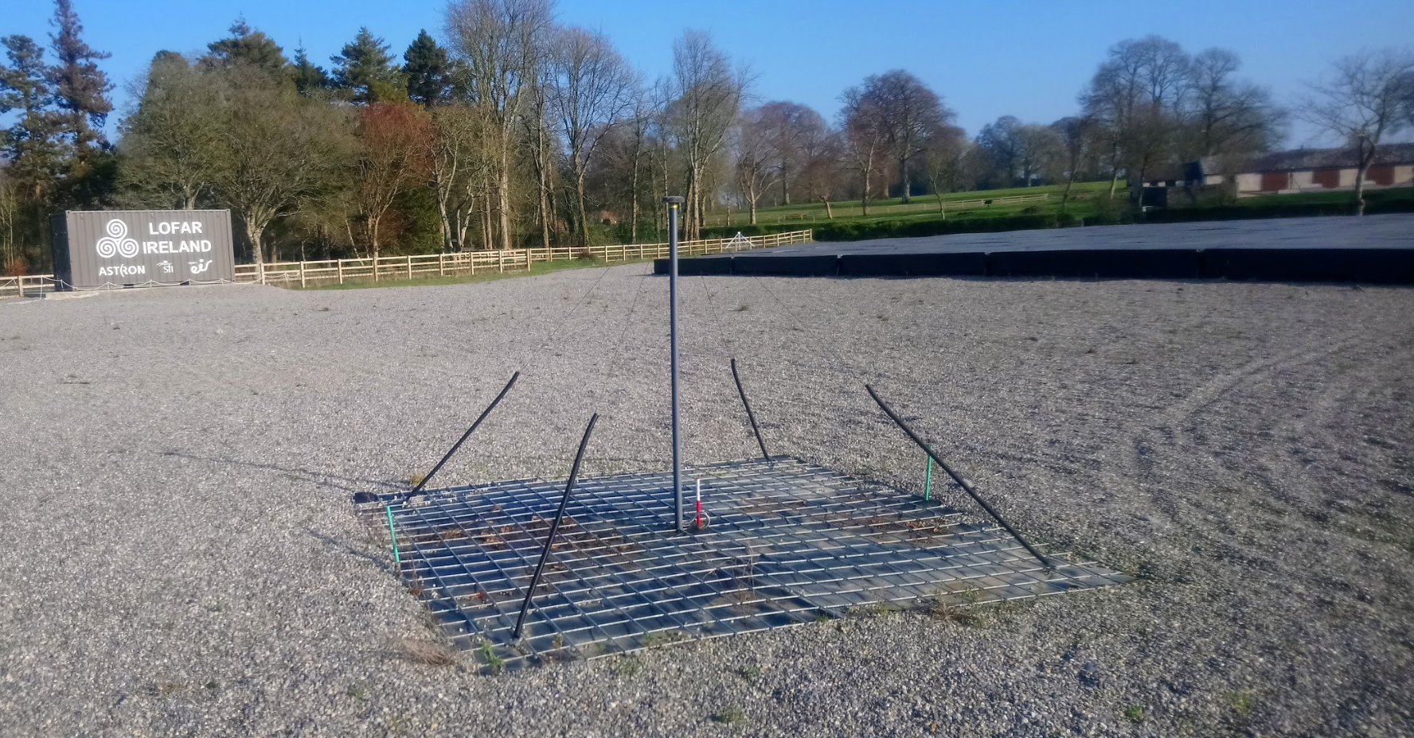
What happens at I-LOFAR?
Two types of antenna
Data can be collected all day everyday
Researchers use this data to learn more about the Universe
High band antennae
Low band antennae
Notes:
The two types of antenna observe radio waves above and below FM radio frequencies.
LBA observe between 10-90MHz
HBA observe between 110-240MHz.
There is gap between 90-110MHz as it is the region terrestrial radio stations transmit in (eg: RTÉ Radio 1 is 88-90FM or 88-90MHz, Today FM is 100-102FM or 100-102MHz, etc) so we don’t observe there as the signals from the radio stations would be far too strong to allow us to see any of the weak signals coming from space.
Radio astronomy works all day, every day, no matter what the weather is as radio waves can come through clouds (perfect for the Irish Midlands) and also be observed during the day and night.

Slide 19
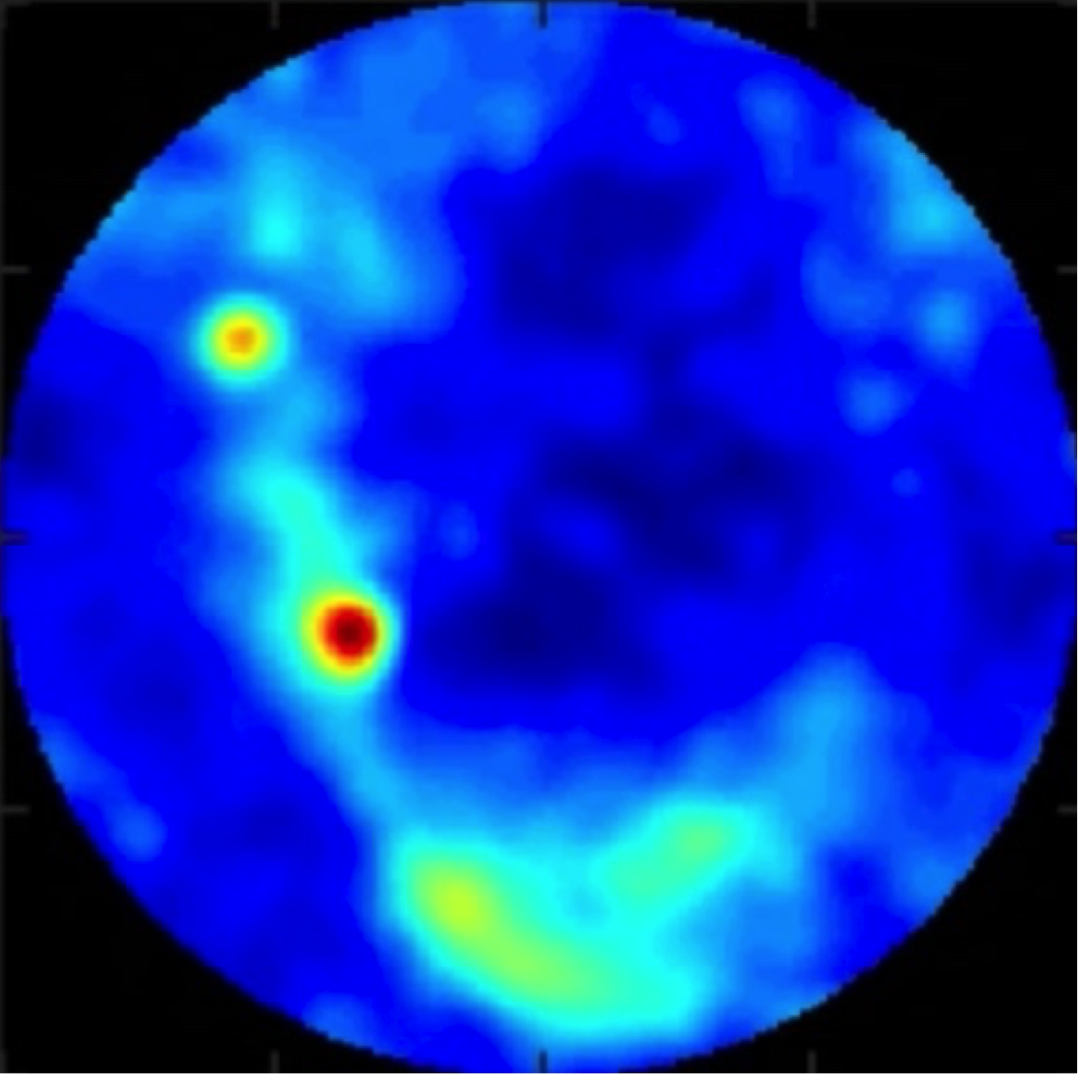
Notes:
What do we see with I-LOFAR?
All the results come in as data which is analysed and processed to create images like this.
This is an ‘all-sky’ image taken over Birr, meaning that we are observing the entire sky above the horizon.
You can see areas of more activity in the yellow and red regions.

Slide 20
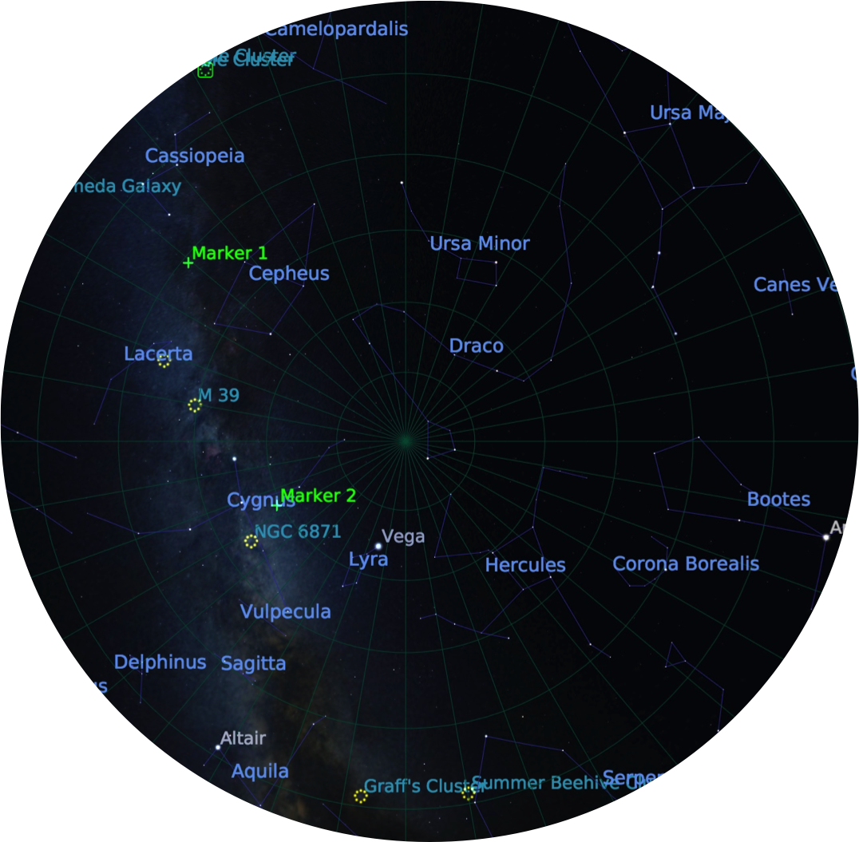
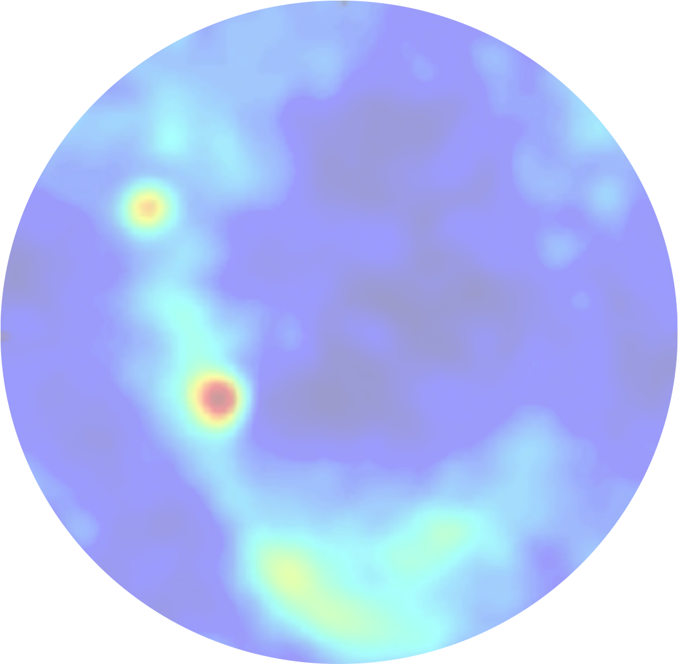
Cassiopeia A (Supernova Remnant)
Cyngus A (Radio Galaxy)
Notes:
We look at the data from I-LOFAR along with data from other sources to understand what we are looking at and if it is as expected or not.
This is the all-sky image with information about what we are looking at, which makes sense of what we are seeing.

Slide 21
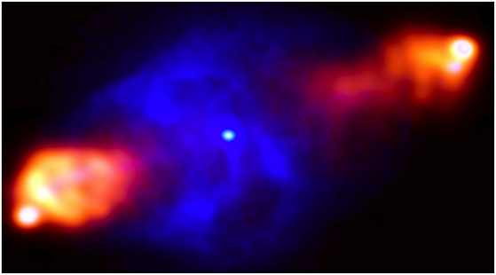
Cassiopeia A (Supernova Remnant)
Cyngus A (Radio Galaxy)
Notes:
We can look at the radio galaxy in more detail by using other radio telescopes giving an image like this.
This shows that science works best as a collaboration with many people, organisations and different instruments around the world to really learn as much as we can about the Universe.

Slide 22

AstroLands
Exploring the Radio Universe from Ireland
lofar.ie @LOFARireland

