Slide 1




Our Solar System to Scale:
Sizes and Distances

Slide 2
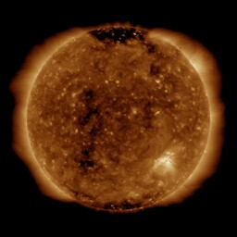
The Sun
Yellow dwarf star
The sun’s atmosphere - or corona - is hotter than the surface of the sun.
100 Earths could fit across the Sun in this image
Notes:
A medium sized star, very average, boring and middle-aged compared to other stars.
The diameter of the sun is about 100 times the diameter of the Earth

Slide 3
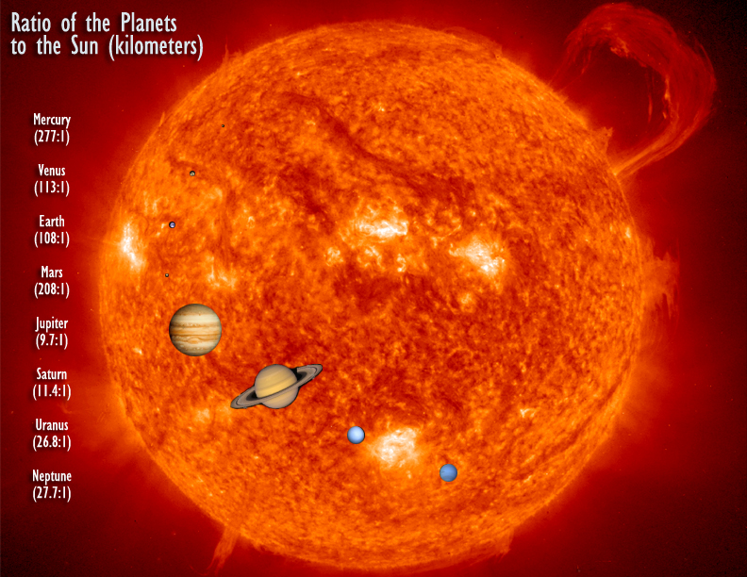
Relative Planet Sizes
https://sdo.gsfc.nasa.gov/
Using classroom objects can you show what size the planets are compared to the big image of the Sun on the next slide?

Slide 4
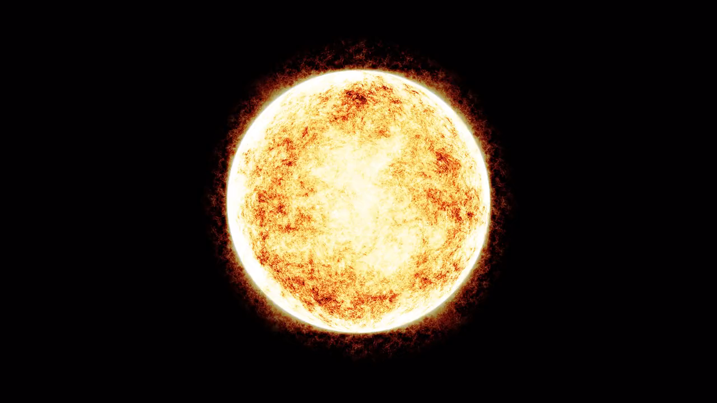
Notes:
In full screen mode the planets roughly should be the size of:
Mercury – small ball bluetack (0.7cm diameter)
Venus & Earth – marbles
Mars- bluetack (1cm diameter)
Jupiter – bouncy ball/ volley ball (20cm diameter)
Saturn - bouncy ball/ volley ball (16.7cm diameter)
Uranus & Neptune – tennis ball

Slide 5
Estimating Distances
With your thin piece of paper estimate where the planets are in between the Sun and Neptune
? ? ? ? ? ? ? ? ? ? ?
Neptune
The Sun

Slide 6
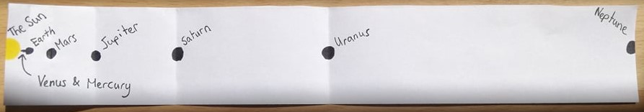
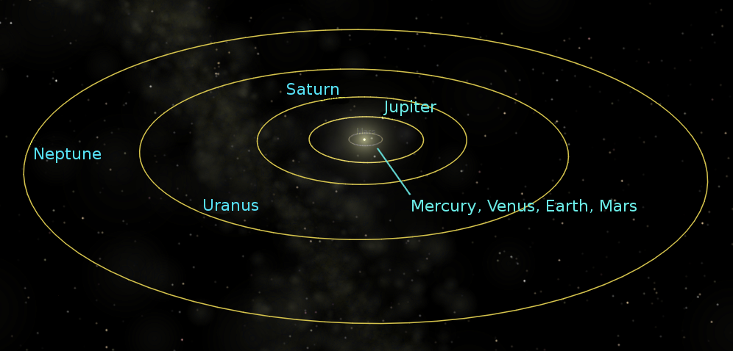
Actual Distances
if the moon were a pixel

Slide 7
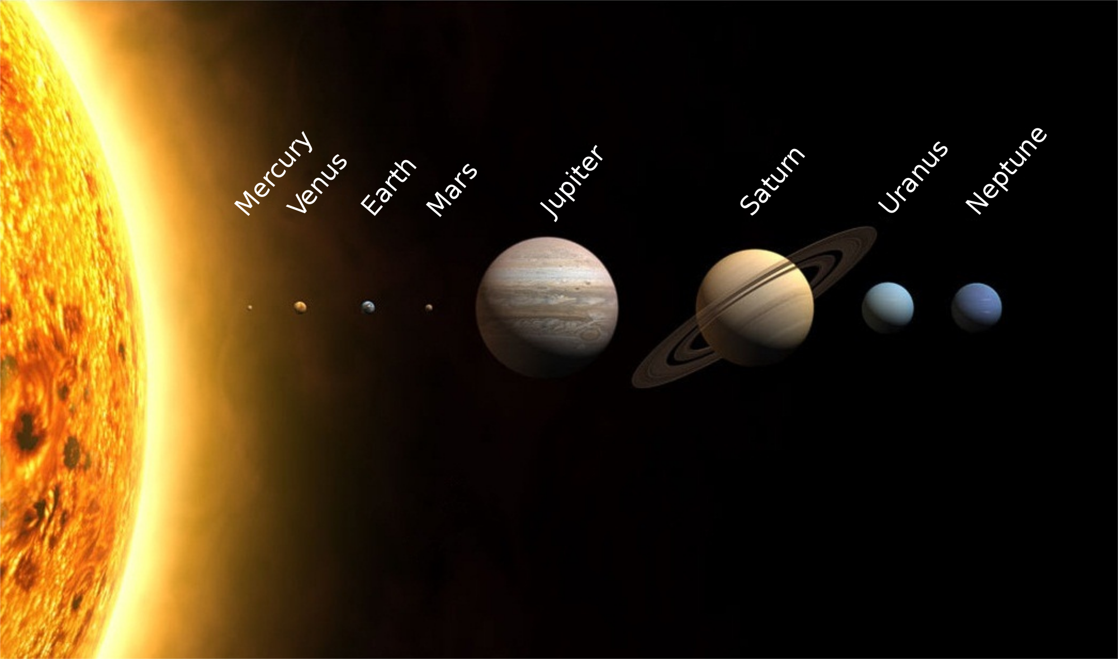
Why do we think this misconception exists?
Notes:
Conversation topic about misconceptions in science.
Might have been easier to make posters and infographics
People chose to focus on people understand all the planets or there size rather than distance

