Slide 1




Gravity and the
Origins of the Universe

Slide 2
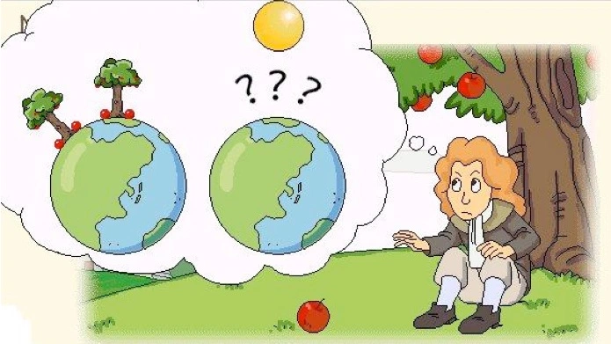
What is gravity?
Gravity is a force of attraction between all matter.
Notes:
When Isaac Newton first discovered gravity, he was wondering why things fall to the ground.
Story of Newton and the apple
On Earth gravity pulls us to the centre and keeps us on the ground, but what does it do in space.

Slide 3
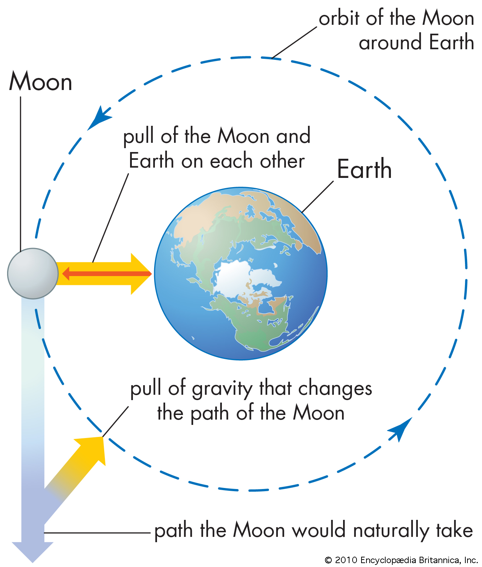
What would happen if suddenly gravity was ‘turned off’?
http://phet.colorado.edu/sims/html/gravity-and-orbits/latest/gravity-and-orbits_en.html
Notes:
It helps the Moon orbit Earth and the Sun has a strong gravitational force which keeps Earth in orbit.

Slide 4
What would have happened if there was no gravity at the beginning of the Universe?
If the universe had begun with no gravity the expansion would have been much faster and space would be much bigger.
However, without gravity there would be nothing to hold matter together, space would be a very empty boring place

Slide 5
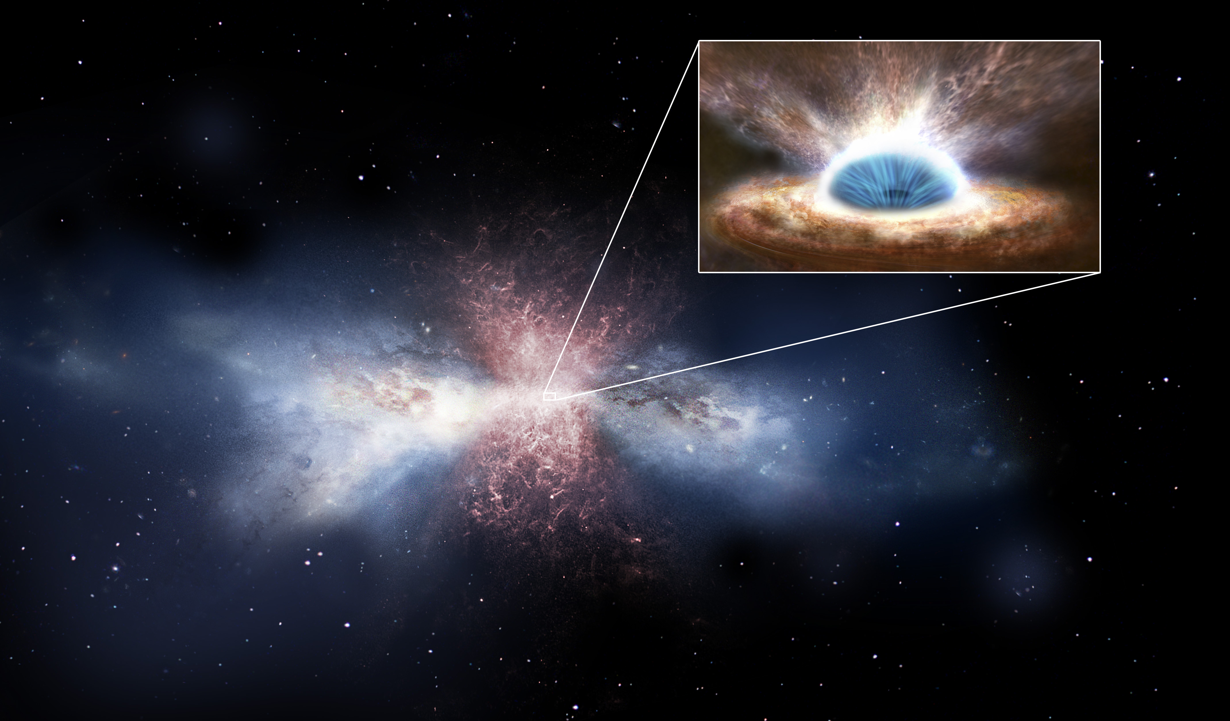
Star Recipe
Ingredients: Time:
Space millions of years
Cloud of dust & gas
Gravity
Method:
Patches of the cloud become more dense, and this increases the force of gravity, causing the cloud to collapse in on itself
The collapse has condensed matter and so it is hotter. The collapse is also occurring faster at its centre and so it begins to spin.
This continues until the core of the cloud is hot enough to fuse nuclei, creating vast amounts of energy.
This energy pushes against gravity and allows the star to become stable
https://youtu.be/mkktE_fs4NA

